Slide 1
Silicon Valley’s Secret Weapon
The SHAdow History of BurnERS
by Steve Outtrim
ALL INFORMATION GATHERED FROM OPEN SOURCE INTELLIGENCE
Images used with permission, under Creative Commons license, or under non-commercial Fair Use
Notes:
Copyright © Steve Outtrim 2012-2016 All Rights Reserved
http://burners.me
http://facebook.com/burnersme
Twitter @burnersdotme
Instagram @burnersdotme
Image by Peter Ruprecht, Ruprecht Studios
BalanceVille Art Car
Unless otherwise noted all images used for educational non-profit purposes, under Fair Use provisions. All copyrights belong to their respective owners. Except where otherwise specified, the wording, contents, narrative, structure, and research of this presentation is copyright© Steve Outtrim 2012-2016 ALL RIGHTS RESERVED
Please contact burners@zos.org for attribution or takedown requests
Any information that may be related to OPSEC of existing or still classified operations is due to mission participants revealing details (particularly in media interviews) which have been reproduced by others on the Internet. Classification markings on any document pertain to the originals, which have been publicly obtained through newspapers, Google, the Internet archive, and other credible sources.
From Creative Commons:
Generally, a modification rises to the level of an adaptation under copyright law when the modified work is based on the prior work but manifests sufficient new creativity to be copyrightable, such as a translation of a novel from one language to another, or the creation of a screenplay based on a novel.
Cropping is very unlikely considered an adaptation (also known as remixes or derivative works). (https://www.flickr.com/help/forum/en-us/72157647717959075/)
Any cropping or size adjustment performed to any image is purely for the purposes of presentation and does not represent any claim by the author to have created a derivative work upon said copyright. Recommended reading:
http://schillerinstitute.org/fid_91-96/921_frankfurt.html
http://www.gnosticmedia.com/manufacturing-the-deadhead-a-product-of-social-engineering-by-joe-atwill-and-jan-irvin/

Slide 2
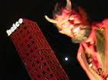
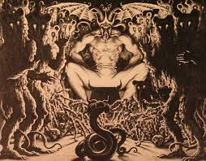
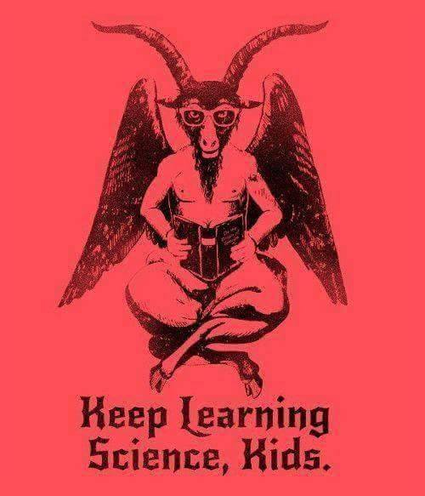
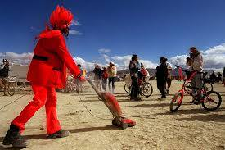
Part 3 Satan’s Birthday Party
Image: Robert Campbell Photography
Notes:
CLIP [SH022] Satanism Intro https://vimeo.com/164362888

Slide 3
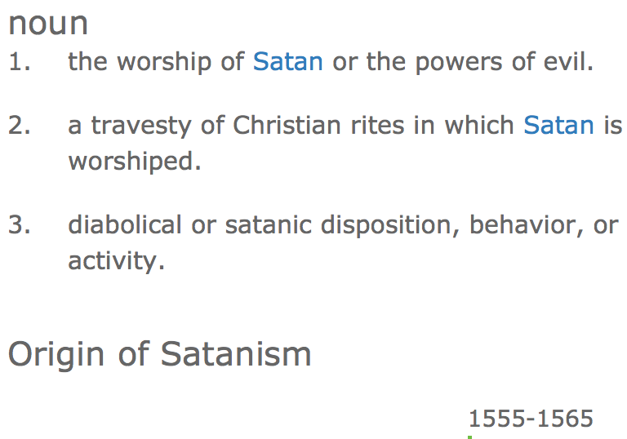
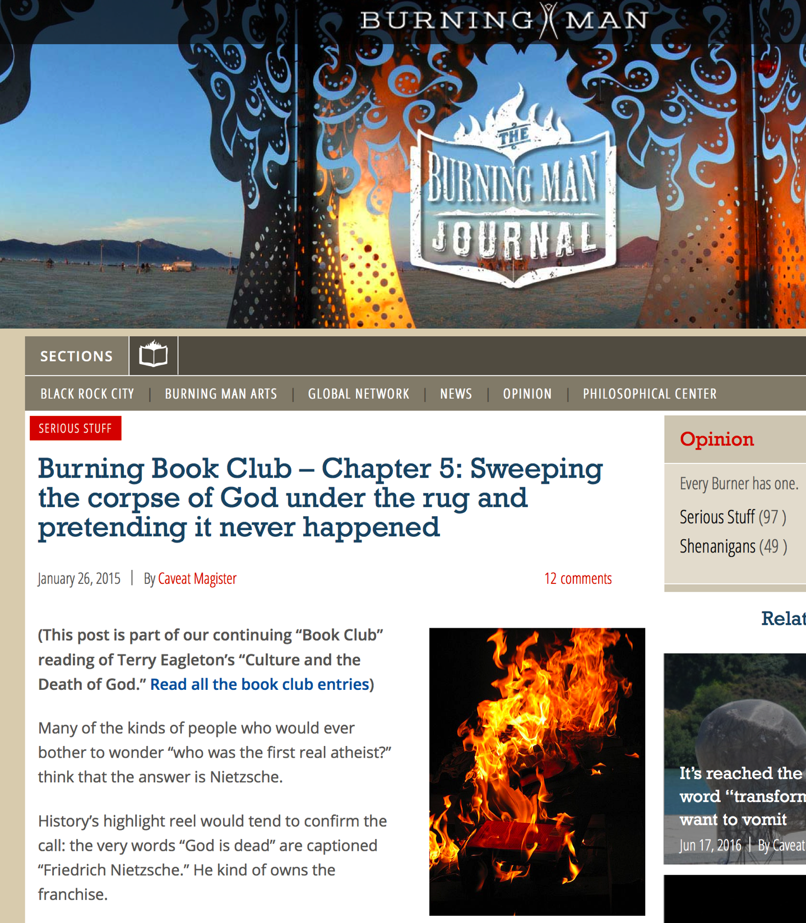
Definitions
The Satanist realizes that man, and the action and reaction of the universe, is responsible for everything, and doesn’t mislead himself into thinking that someone cares.
Is it not more sensible to worship a god that he, himself, has created, in accordance with his own emotional needs—one that best represents the very carnal and physical being that has the idea-power to invent a god in the first place?
Satanism not devil worship; “I-theists”
Atheism different from “agnostic”; atheism=scientism
Luciferianism Devil worship
Nihilism ”nothing is real”; denial of self and senses, solipsism
Monism everything is one, we are all one
Dualism good and evil, co-eternal binary opposition
Syntheism artificial god; Kurzweil, Singularity
Self is god message of Aquarian conspiracy, New Age movement, Burning Man
Death of god Thus Spake Zarathrustra; natural aristocracy of the superman
Nietzsche uber-mensch; Super Man, X-Men, entire Marvel genre
Source: churchofsatan.com
Source: dictionary.com
Luciferianism is a belief system that includes both theistic and atheistic denominations and is, therefore, heavily influenced by differing personal beliefs. Considered by many to be a religion, and by some to be a philosophy or way of life, Luciferianism as a whole has no specific dogma to which its followers adhere. Rather, it encompasses a broad range of beliefs with numerous personal variations, ranging from the veneration of a literal deity and the practice of occultism, to a secular set of principles that use mythological references as a form of symbolism and cultural tradition.
Source: Wikipedia
Source: burningman.org
Notes:
Verbal kint clip https://www.youtube.com/watch?v=v6CqiShbBgo
http://journal.burningman.org/2015/01/opinion/serious-stuff/burning-book-club-chapter-4-sweeping-the-corpse-of-god-under-the-rug-and-pretending-it-never-happened/
https://en.wikipedia.org/wiki/Luciferianism
https://en.wikipedia.org/wiki/Nihilism
https://en.wikipedia.org/wiki/Solipsism
https://en.wikipedia.org/wiki/Monism
https://en.wikipedia.org/wiki/Dualism
http://mb-soft.com/believe/txn/deathgod.htm
https://en.wikipedia.org/wiki/Syntheism
Three Devil-worshippers walk into a desecrated church ― stop me if you’ve heard this one. They light candles, burn incense, and, much to their surprise, they successfully summon Satan! When they bow down to worship His Infernal Majesty, He says, “Haven’t I taught you anything?!”.
Satanism applies the principles that define the very nature of Devils: the rejection of external gods, the embrace of carnality, and a stance of honest individualism.
Again: Satanists do not worship Satan. Rather, we emulate that mythological figure’s most productive qualities, rejecting the rest as anti-carnal propaganda.
[http://www.churchofsatan.com/on-definition-of-satanism.php]
The Satanist realizes that man, and the action and reaction of the universe, is responsible for everything, and doesn’t mislead himself into thinking that someone cares.
Is it not more sensible to worship a god that he, himself, has created, in accordance with his own emotional needs—one that best represents the very carnal and physical being that has the idea-power to invent a god in the first place?
…Accepting the axiomatic premise that no gods exist as independent supernatural entities means that Satanists are de facto atheists. We know that the objective universe is indifferent to us. Since our philosophy is self-centered, each Satanist sees himself as the most important person in his life. Each individual thus generates his own hierarchy of values and judges everything based on his own standards. Therefore, we Satanists appoint ourselves as the “Gods” in our subjective universes. That doesn’t mean we think we have the powers of a mythological deity, but it does mean that we revere the creative capacity in our species. So to distinguish ourselves from the atheists who simply reject God as non-existent, we call ourselves “I-theists,
[http://www.churchofsatan.com/what-the-devil.php]

Slide 4
Journey of a Satanist from observation to acceptance
Nature encompasses all that exists. There is nothing supernatural in Nature.
The spiritual is an illusion. I am utterly carnal.
Reason is my tool for cognition making faith anathema. I question all things. I am a skeptic.
I do not accept false dichotomies, finding instead the “third side” which brings me closest to understanding the mysteries of existence.
The universe is neither benevolent nor malevolent; it is indifferent.
There are no Gods. I am an atheist.
There is no intrinsic purpose to life beyond biological imperatives. I thus determine my own life’s meaning.
I decide what is of value. I am my own highest value therefore I am my own God. I am an I-theist.
Good is that which benefits me and promotes that which I hold in esteem.
Evil is that which harms me and hinders that which I cherish.
I live to maximize the Good for myself and those I value. At all times I remain in control of my pursuit of pleasure. I am an Epicurean.
Merit determines my criteria for the judgment of myself and others. I judge and am prepared to be judged.
I seek a just outcome in my exchanges with those around me. I thus will do unto others as I would prefer they do unto me. However, if they treat me poorly, I shall return that behavior in like degree.
I grasp the human need for symbols as a means for distillation of complex thought structures.
The symbol that best exemplifies my nature as an aware beast is Satan, the avatar of carnality, justice, and self-determination.
I see myself reflected in the philosophy created by Anton Szandor LaVey.
I am proud to call myself a Satanist.
Source: churchofsatan.com
Notes:
Source: http://www.churchofsatan.com/what-the-devil.php
CLIP SH020 Anton LaVey https://vimeo.com/164360650

Slide 5
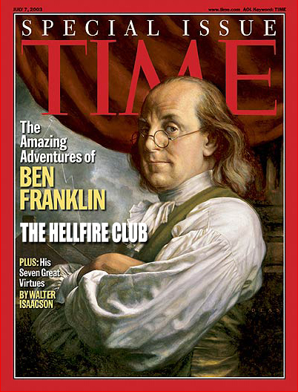
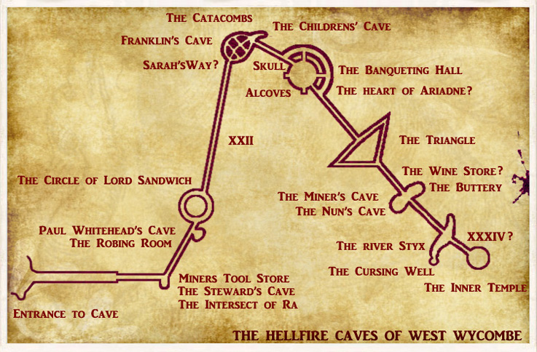
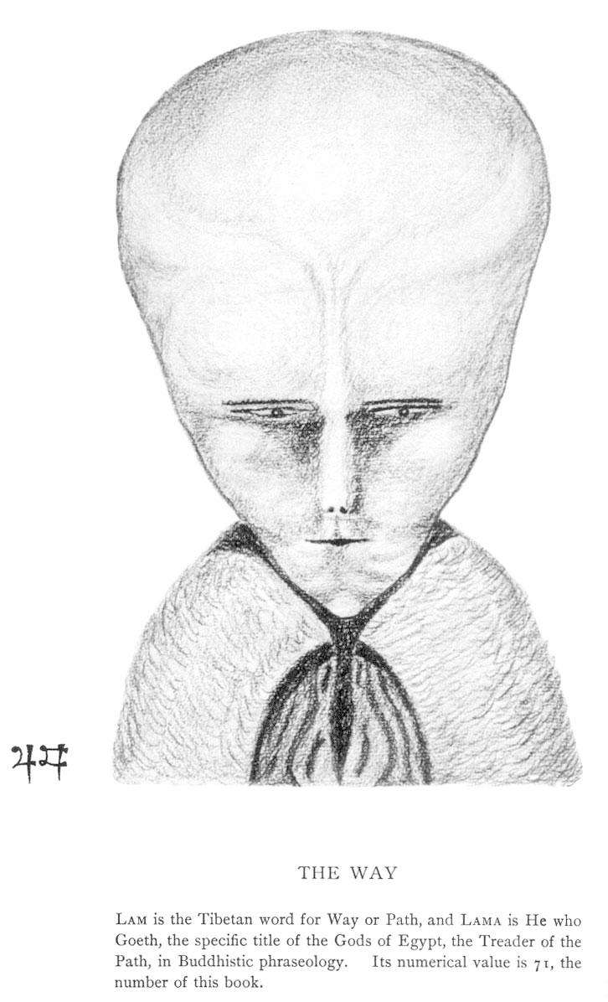
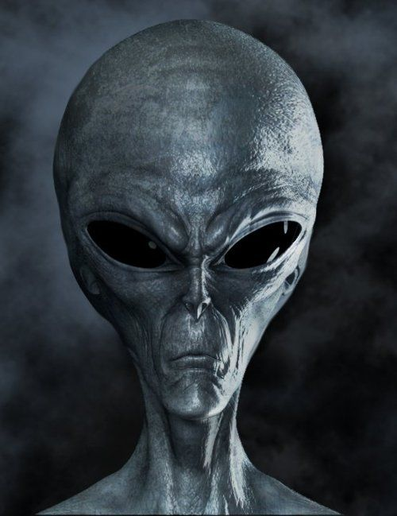
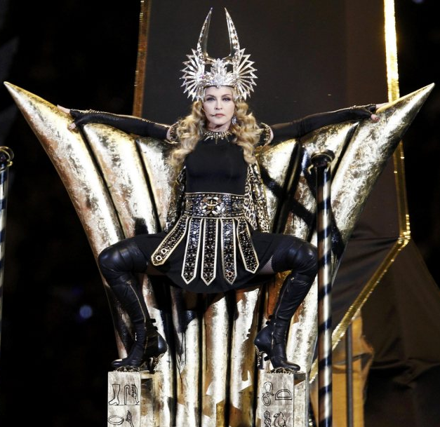
Evolution of Modern Satanism
1500’s Sir Francis Walsingham and John Dee 007; birth of British Intelligence. Summoning demons, seances. Kelly
1700’s Hellfire Club Order of Friars of St Francis; Dashwood, Franklin, Earl of Sandwich, John Wilkes; espionage; Eleusian rites
1900’s OTO Crowley(Intelligence Agent) consolidating theosophy, freemasonry, Illuminati
1940’s Jack Parsons, L Ron Hubbard Agape Lodge; Crowleyan cell – Sex & Rockets
1948 Ophite Cultus Satanas Herbert Arthur Sloane (Army); “Our Lady of Endor” coven, Ohio
1960’s OTO and Rock & Roll
Beatles, Stones
Black Sabbath, Led Zeppelin
Rap music
1965 Process Church of Final Judgement London; splintered from Scientology
1966 Church of Satan Anton LaVey, 66; Aquino, 70
Satanic Wedding – Navy
Jayne Mansfield (curse), Sammy Davis Jr
Aleister Crowley, Timothy Leary, Michael Aquino main figures
1975 Temple of Set Lt Col Michael Aquino, North Solstice 75; channeled from Crowley’s Lam
1984 McMartin Preschool birth of “Satanic Panic” of 80’s
1985 OTO leadership challenges resolved McMurtry dies; Breeze takes over on equinox
1986 First (?) Burning Man on Baker Beach North Solstice
1987 Presidio Satanic Ritual Abuse scandal; spreads to 15+ bases
1996 Burning Man “Helco” Satanic Parade; first theme; first death
1998 Burning Man “Nebulous Entity” first Pentagon; Google launch
Contemporary Satanism is mainly an American phenomenon, the ideas spreading with the effects of globalization and the Internet…
It was estimated that there were 50,000 Satanists in 1990. There may now be as many as 100,000 Satanists in the world
Notes:
https://en.wikipedia.org/wiki/Yerba_Buena,_California
http://www.newdawnmagazine.com/articles/the-british-occult-secret-service-the-untold-story
Sir Francis Dashwood founded a secret society called the Order of the Friars of St Francis of Medmenham (more popularly known as the Hellfire Club) named after the abbey he had purchased on the banks of the River Thames where its meetings were held. Rumours circulated in the coffee houses of London that the Friars practised sexual orgies featuring aristocratic ladies and prostitutes dressed up as nuns. There were also satanic rites such as Black Masses where the naked body of a noblewoman acted as an altar. However, according to one senior member of the Hellfire Club, this occult mummery was just an amusing diversion for the dandies. The inner circle of the Order was actually dedicated to the serious revival of the pagan Eleusian Mysteries and the worship of the Bona Dea or Great Mother Goddess. Dashwood’s present-day descendant, also called Sir Francis, confirmed this fact in a BBC radio interview some years ago,
It has been claimed secret agents infiltrated the Hellfire Club because of its many famous members. They included the Earl of Sandwich, John Montagu, who was the First Lord of the Admiralty, the Paymaster General Thomas Potter, several members of Parliament, the Lord Mayor of London, a son of the Archbishop of Canterbury, the Earl of Bute, who was the prime minister, and it has been claimed even the Prince of Wales. At least four members of the group were known to be actively involved in espionage. They was a radical MP called John Wilkes, a transvestite French diplomat, Chevalier D’Eon de Beaumont, the American statesman and philosopher Benjamin Franklin, and Sir Francis Dashwood himself. Wilkes had allegedly recruited the chevalier into the British Secret Service.
https://en.wikipedia.org/wiki/John_Dee
https://en.wikipedia.org/wiki/Francis_Walsingham
https://en.wikipedia.org/wiki/Our_Lady_of_Endor_Coven
https://en.wikipedia.org/wiki/McMartin_preschool_trial
http://oto-usa.org/oto/history/
https://en.wikipedia.org/wiki/The_Process_Church_of_The_Final_Judgment
http://la.curbed.com/2014/10/21/10033360/the-pasadena-haunts-of-the-occultist-who-cofounded-jpl
https://en.wikipedia.org/wiki/Witch_of_Endor
https://en.wikipedia.org/wiki/Our_Lady_of_Endor_Coven

Slide 6
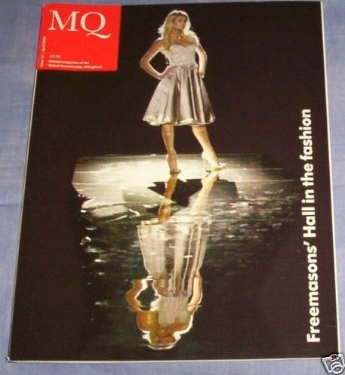
Sold Their Soul to Rock & Roll
“I’ve sold my soul to the devil.” - John Lennon
“Satan is my master.” - Justin Timberlake
“I sold my soul to the devil.” - Kanye West
“I sold my soul to the devil.” - Kathy Griffin
“I sold my soul to the devil” - Katy Perry
“Them demons got me. Dear Lord save me! the Devil’s working hard.” - Kendrick Lamar
“I will get stoned and worship Satan.” - Kurt Cobain
“Judas (Devil) is the demon I cling to.” - Lady Gaga
“In the devil’s game. Even sell my soul to the devil.” - Michael Jackson
“I tried to empty myself and let the spirit of Sethe inhabit me.” - Oprah Winfrey
“Sometimes I feel like I’m possessed with a multitude of demons.” - Johnny Depp
“I met the spirit of music. An appearance of the devil, on a Venice canal, running I saw Satan.” - Jim Morrison
“It’s like being possessed: like a psychic or a medium. I felt like a hollow temple filled with many spirits, each one passing through me, each inhabiting me for a little time and then leaving to be replaced by another.” - John Lennon
“I sold my soul. Sellin’ my soul for material wishes, fast cars and bitches. Am I cold, or is it just I sold my soul?” - Tupac Shakur
“I can’t explain it to you man. I go through my Rain Man, and I just start mumbling. I got possessed by the spirits.” - Jay-Z
“My soul is possessed by this devil my new name is Rain Man.” – Eminem
“Sell his soul for cheap. Let’s make a deal, sell me your soul. Designer of the devil.” - 50 Cent
“The dark covers me and I cannot run now.” - Amy Winehouse
“I made a bargain with him, the chief in a world we can’t see.” - Bob Dylan
“I could really try new things. That was satanism, it works really well, I made a pact.” - Brad Pitt
“I never knew that I would see the day that I would meet the devil himself.” - Busta Rhymes
“Rock’s always been the devil’s music.” - David Bowie
“If you sell your soul to the devil, you get more grain.” – Drake
“I sold my soul to the devil.” - DMX
“Get thee behind me Satan, and push me along. I’m kin to the devil.” - Eazy-E
“You sold your soul at the crossroads. Devil, Satan, Satan.” - Elton John
“Because I’m evil.” - Elvis Presley
“Sold my soul to Satan. I’ve been dancing with the devil. So when you get to hell you can say you know me. I’m easily attracted by the dark side. Devil keep following.” - J. Cole
“I sold my soul to the devil. I’m going to hell. I’m headed to hell. I want the money, the women, the fortune, and the fame. That means I’ll end up burning in hell scorching in flames. Satan’ll be in to see me later to see if I’m interested in being partners. Devil worshippin’, Satan music.” – Eminem
“The devil comes and soon my subconscious and conscious might start to brawl. As this cunning demon takes me as its voodoo doll.” – Fergie
“I’m the devil’s advocate. We have our own worshipers.” - Frank Zappa
“I graduated into the occult.” - Hall & Oates
“The devil comes to bring a fate you couldn’t imagine in your wildest dream.” - Hilary Duff
“I love Satan. Satan sells tickets.” - Jack Black
“Never prayed to God, I prayed to Gotti, that’s right it’s wicked, that’s life I live it. Ain’t askin’ for forgiveness for my sins. I gotta get my soul right, I gotta get these Devils out my life. Lord forgive him, He got them dark forces in. connected to the high power.” - Jay-Z
“She got the devil in her, I do whatever I want, hell’s angel. (Lucifer) Dance with the devil. Devil on my shoulder” - Lil Wayne
“Lucifer, oh Lucifer, God of evil, you’re the god of pain, the darkness is where you find your light.” – Ludacris
“First of all, we want to thank Satan.” - Red Hot Chili Peppers
Peaches Geldof (RIP) Image: Daily Mail
Source: theocculttruth.com
Notes:
Mickey Mouse Club photo features: Ryan Gosling, Britney Spears, Christina Aguilera, and Justin Timberlake – 1993 http://www.thedailybeast.com/articles/2013/11/15/it-s-been-20-years-since-britney-spears-justin-timberlake-and-ryan-gosling-joined-the-mickey-mouse-club.html
List chosen from https://web.archive.org/web/20150522131309/http://theocculttruth.com/index.php?p=1_156
Bob Dylan admits to making a deal with the Chief Commander of this world and a world we can’t see: https://www.youtube.com/watch?v=IqvvOD4bdRs
Jack Black: https://www.youtube.com/watch?v=jc1NL4Pp7mQ
Hannah Montana: http://science-all.com/files/hannah-montana.html
Miley Cyrus original audition tape, age 12 http://hollywoodlife.com/2015/06/04/miley-cyrus-hannah-montana-audition-tape-video-watch/
Wash Your Brain – Hollywood Mind Control, Freeman TV 2011 (esp 34:00) https://www.youtube.com/watch?v=szwvjyiGBSk
Hannah Montana products at the store (2011): https://www.youtube.com/watch?v=Nf2o5tdcj58
Miley, Disney in World War II, Princess Programming, and Satanic Sodomite rituals http://freemantv.com/miley-cyrus-invokes-kali-vma-2013/
Ordo Templi Orientis logo from their US site: http://oto-usa.org/oto/
http://loveforlife.com.au/content/12/02/23/how-cia-and-military-control-music-industry-wes-penre-illuminati-news-21st-december
The Satanic Roots of Rock http://100777.com/node/151
http://www.dailymail.co.uk/femail/article-2312632/Introducing-Satanic-sex-cult-thats-snaring-stars-Peaches-Geldof.html
Paris Hilton Inherited Marianne Faithful's role as Priestess of the Mysteries; Kenneth Anger's DJ – Leo Zagami, Confessions of an Illuminati Part 1 pg 52

Slide 7
OTO Celebrities
Peaches Geldof RIP
John Lennon shot outside Rosemary’s Baby building, CIA doorman
Jimmy Page bought Boleskin Castle, Crowley’s
Jay-Z & Beyonce Illuminati, Roc-a-Feller; took over Def Jam from Russell Simmons
Rihanna
Paul McCartney Paul is Dead conspiracy, forensic evidence on face, ears, height, and voice print; clues
Kanye West
Madonna
Mick Jagger London School of Economics
David Bowie ritualized death & album launch; Tavistock
Sting Burner
Russell Brand
Daryl Hall
Johnny Cash
Ozzy Osbourne
Jim Morrison
Timothy Leary
Stanley Kubrick
George Lucas
Marilyn Manson
Iron Maiden
Tool
Chris Martin
James Franco Burner
Kenneth Anger
John Carradine
Alan Moore V for Vendetta, Watchmen, From Hell
Grant Morrison Batman, Superman, X-Men, Fantastic Four, The Invisibles
Wachowskis – Andy, Lana The Matrix trilogy
John Frusciante Red Hot Chilli Peppers
Adam Lambert Burner
Source: ranker.com
Source: statista
Notes:
Source: http://www.ranker.com/list/famous-ordo-templis-orientis-members/user-x
2013 Look magazine article from: http://www.evilyoshida.com/thread-959.html
Music industry stats from Statista: http://www.statista.com/topics/1639/music/

Slide 8
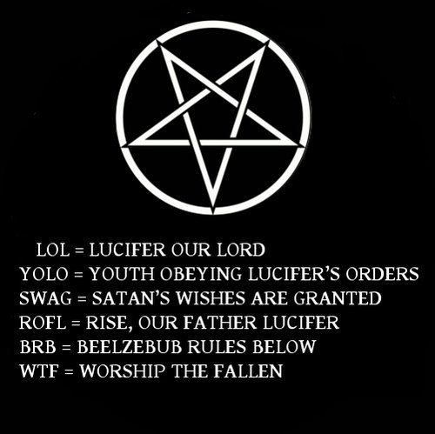
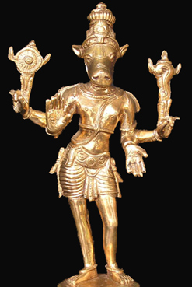
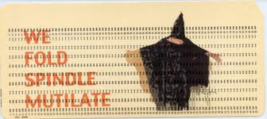
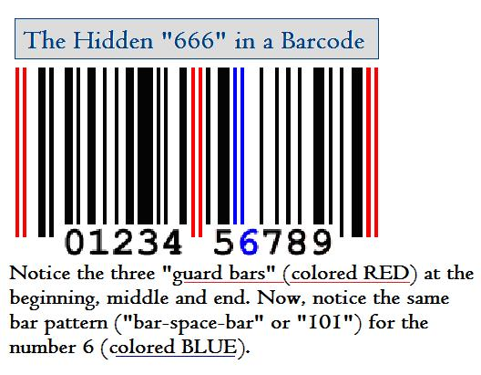
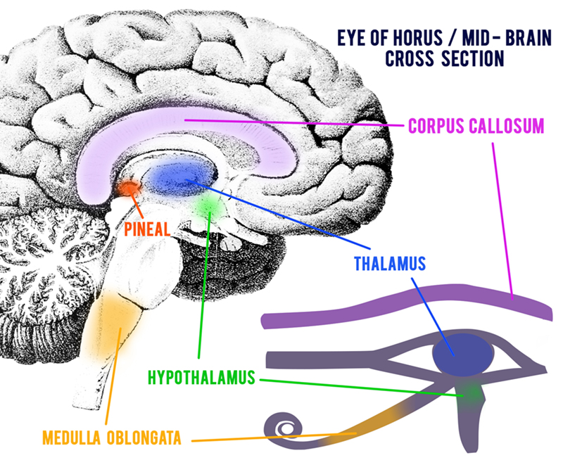
Black Magick on the Internet
Apple I: $666 bite links it to fall of Man, the serpent
Charles Babbage summoned Devil in a pentagram; Satanic Mills
Norbert Wiener and the Golem
SUBMIT
CONTROL
Mouse meek, sub-human, lab rat
Hack, Slash
Hit Keys, Punch cards
LOL = Lucifer Our Lord
Trolls, Daemons
WWW = v v, v v, v v Sabbateans; Vav/Nail; 6
DEMONstration
Gateway
Avatar god incarnating in material form as animal or mythical creature
Mirror occult concept
Image i-Mage, FaceBook “fae spook”, Delete “d’elite”
Terminal death
The “Net” capturing, trawling
The “Web” stickiness
Spiders, crawlers
# Hash tag octothorpe; military stripes; hashashins; Bell Labs; checkmate
@ All Seeing Eye, sacred spiral amphora
Enter enter into agreement; enter Plato’s cave; “inter” (dead)
CANCEL cancer, cancer cell; can sell your soul
Return it belongs to someone else
Screen obscures what’s behind it
.ORGy
Notes:
Original Apple adverstisement source: http://dcnewsman.blogspot.com/2011/10/apple-computer-steve-jobs-sold-his-soul.html
Quote around original Apple advertisement: Newton...a mind forever voyaging through strange seas of thought...alone"
Apple logos: http://crownmarketers.com/2015/02/15/brand-of-the-week-apple/
Inverted Apple logo shows alien: http://pinballking.blogspot.com/2011/10/apple-computers-and-occult.html
Gmail logo is Royal Arch Mason apron: http://illuminatisymbols.info/gmail-logo-masonic-apron/
“G” = Masonic
http://ideas.time.com/2013/09/23/the-history-of-and-6-other-symbols-that-rule-twitter-and-the-web/slide/at-symbol/
# octothorpe: http://blog.dictionary.com/octothorpe/
The word hash predates these other terms but was not very popular until recently. (Maybe because it reminds us of mediocre diner food.) It first referred to stripes on military jackets as early as 1910. In the 1980s, it came to refer to the # symbol. Since the ascent of social media, hashtag has become the favored word for the # symbol.
Octothorpe means checkmate: http://gizmodo.com/before-the-hashtag-there-was-the-octothorpe-1672570850
Norbert Weiner studied under Bertrand Russell: http://www.britannica.com/biography/Norbert-Wiener
Excellent look at Weiner’s role in history by Howard Rheingold: http://www.rheingold.com/texts/tft/5.html
The V sign symbolizes Sabbatean Frankist Satanism (Bavarian Illuminati) http://www.whale.to/b/v_s.html
666 barcode http://www.av1611.org/666/barcode.html
http://www.wired.com/2012/12/upc-mark-of-the-beast/
http://www.rense.com/general20/666.htm
From http://www.666truth.org/history/antichrist-myths/articletype/articleview/articleid/901/pageid/913
the lines (the left, middle, and right) that protrude below the code represent the numbers 6, 6, and 6. One person even put it this way: “It is interesting to note that the Greek word translated ‘mark’ is charagma which comes from the Greek word charax, which means ‘a palisade, like a picket fence.’ When one realizes that this specific word was used back in the first century, and we see today the use of the computer-related bar code, we find the possibilities becoming more than a reality in our day and age” (Robert Van Kampen, The Sign, 1992, p. 231). The UPC code actually works by representing numbers as a series of seven black and white vertical lines. When scanned by a computer, these groups of lines register the digits you see below the code. Every product you buy has a 10-digit number — the extra three bars allow the computer to know when to start checking for numbers and when to stop checking for them. Mr. Laurer himself has addressed the rumor this way: “There is nothing sinister about this nor does it have anything to do with the Bible’s ‘mark of the beast’ … It is simply a coincidence like the fact that my first, middle, and last name all have 6 letters. There is no connection with an international money code either.” - See more at: http://www.666truth.org/history/antichrist-myths/articletype/articleview/articleid/901/pageid/913#sthash.gMaKTRTI.dpuf
There is a Snopes on it. http://www.snopes.com/business/alliance/barcode.asp
Snopes is worthless, says Roger Ailes http://rogerailes.blogspot.com/2009/12/snopes.html
Snopes is a front for George Soros, has military ties http://techyum.com/2011/04/the-truth-about-snopes-obama-and-aspartame/
Snopes founder says he used to work for computer company contracting to Department of Defense http://io9.gizmodo.com/meet-the-mysterious-creator-of-rumor-debunking-site-sno-1655124697
Google’s offshore profits are washed through a postbox in Bermuda, # 666 http://www.dailymail.co.uk/news/article-3425097/Don-t-evil-Google-sends-profits-worth-8BILLION-year-post-box-number-666-tax-haven-island-Bermuda.html

Slide 9
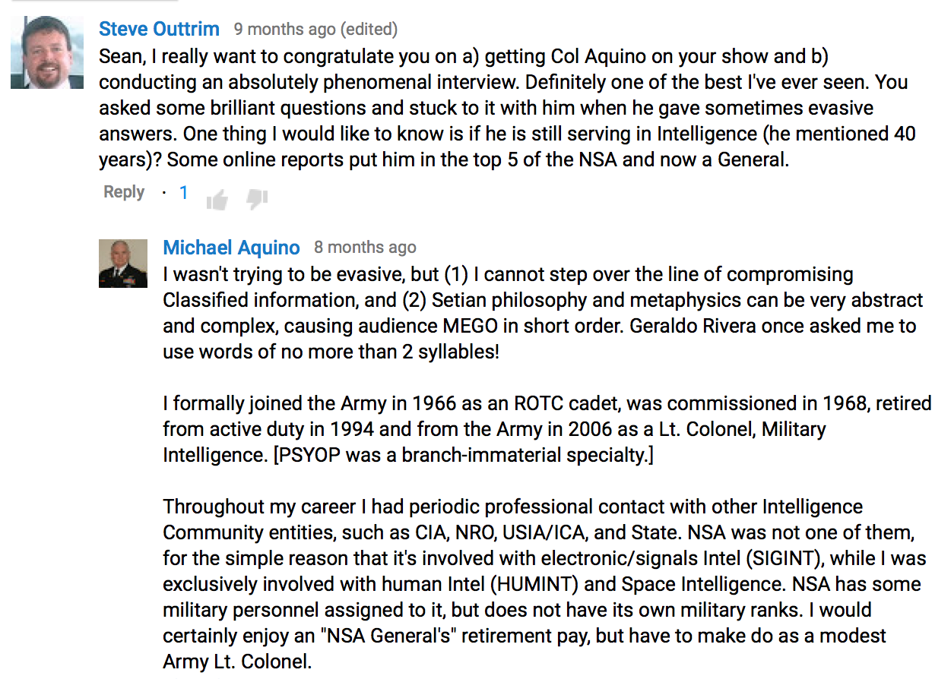
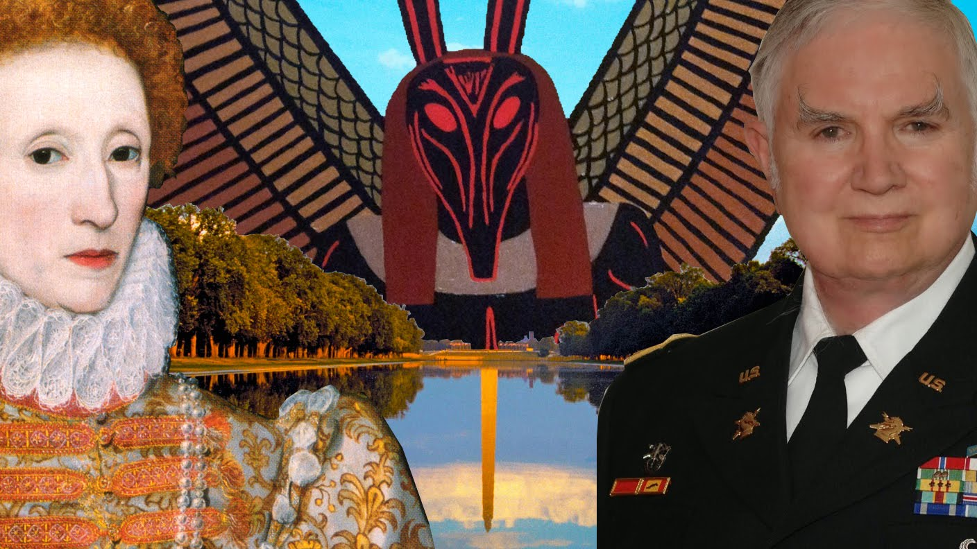
Lt Col Dr Michael Aquino
Images: The Lip TV, Buzzsaw via YouTube
Notes:
Note his comment that PSYOP was a branch-immaterial specialty. This is how Army, Navy, Air Force, and Marines can all be mixing together with people from SRI, Lockheed, and Google.
Sean Stone interview with Michael Aquino: http://thelip.tv/episode/government-mind-wars-psyops-breaking-church-satan-michael-aquino/
https://www.youtube.com/watch?v=J0EN65XLv94
In his book “Black Magic”, Aquino likens Lesser Black Magic to Propaganda and Politics. He describes stagecraft and NLP techniques.

Slide 10
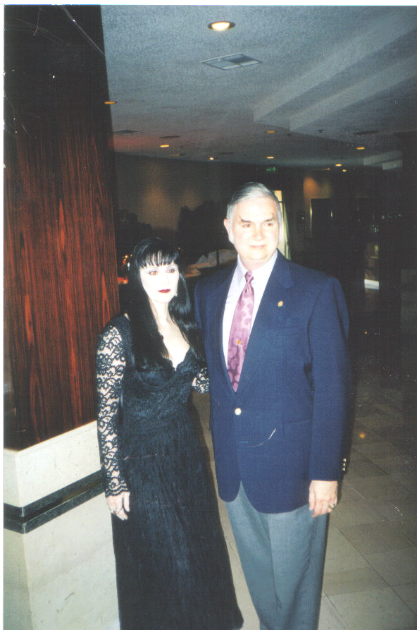
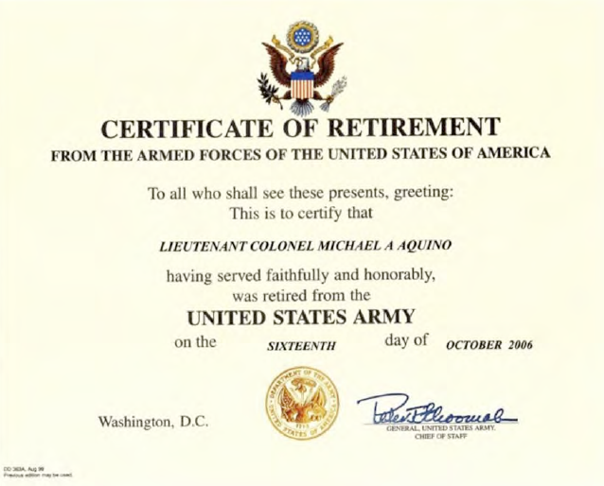
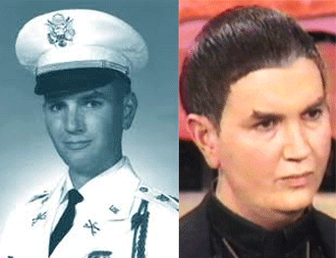
Lt Col Michael Aquino
13th Baron of Rachane, Scotland animal welfare (22 charities); Clan Campbell
Mother Dr Betty Ford early female genius at Stanford; Lewis Terman; founder KPFA-FM (Berkeley)
Saw LaVey in 1968 at Rosemary’s Baby Premiere at Presidio Theater
Joined Church of Satan 1970 Council of 9, Cloven Hoof; literally wrote book on Church of Satan
Lilith Sinclair current wife ran New York coven of Church of Satan
Vietnam Psy-ops blood curdling screams from helicopters
HUMINT, PSYOP Special Forces, Space Intelligence; Deputy Director Reserve Training at Presidio
Added Satanism, Temple of Set, Wicca, Paganism to military’s official religions
Also worked as investment banker, political science professor
“North Solstice” annual greater black magick rituals; channeling Set
Some of the tunnels and gun batteries around Presidio have evidence of Satanic rituals
Uses Nazi ceremonial daggers
Wewelsburg Castle grail ritual in Himmler’s Black Sun occult chamber, exploring “laboratory of the Gateway to the Soul” ; while seconded to NATO (83)
Linked to Presidio Daycare Satanic Ritual Abuse scam/scandal (86-89) googoo doodle game
Aquino investigated, never charged. Titled by Army; lost appeal to remove Titling
Spread to West Point, Fort Dix, Fort Bragg, Panama, Germany, 15+ other military schools
Lt Col. Aquino left SF moved to Army Personnel Center St Louis (88), Space Intelligence (90)
Denounced accusations as financial scam, wrote a book defending himself; continued career, Army sent to multiple colleges; merit award for service 84-94; retired 06
Image: mindcontrolblackassassins
Notes:
Clip: [SH021] Aquino Nazi Dagger and Wewelsburg https://vimeo.com/164360745
Image: https://mindcontrolblackassassins.com/2013/07/22/george-zimmerman-the-shadow-of-himmler-cia-mk-ultra-and-the-providence-of-god/
Account of magic rituals, book burning, occult grimoires from Department of Defense Librarian Douglas Dietrich, who was Colonel Aquino’s personal librarian for 10 years. Interview with Sean Stone: https://www.youtube.com/watch?v=ACNt2uJb2cc
Account of Wewelsburg castle rituals in Nazi SS leader Heinrich Himmler’s Black Magick Chamber : Dr Michael A Aquino and Lilith Aquino Interview https://www.youtube.com/watch?v=8GI8XThaJrk
Aquino says (YouTube comments, 2015):
My experiences at the Wewelsburg Castle are detailed in my memoir of the Temple of Set: http://www.amazon.com/dp/1497567459 The Castle and its specialized chambers had nothing whatever to do with evil. Himmler's intention was to recreate the Grail Castle of Wagner's Parsifal, and to materialize the Grail therein. It was to be a laboratory of the Gateway to the Soul.
Also: http://www.larouchepub.com/other/2005/3233aquino_profile.html
the Pentagon had already given its de facto blessings to Aquino's long-standing public association with the Church of Satan and his own successor "church," the Temple of Set. This, despite the fact that Aquino's Satanic activities involved overt support for neo-Nazi movements in the United States and Europe. On Oct. 10, 1983, while travelling in West Germany on "official NATO business," Aquino had staged a Satanic "working" at the Wewelsburg Castle in Bavaria. Aquino wrote a lengthy account of the ritual, in which he invoked Nazi SS chief Heinrich Himmler: "As the Wewelsburg was conceived by Heinrich Himmler to be the 'Mittelpunkt der Welt' ('Middle of the World'), and as the focus of the Hall of the Dead was to be the Gate of that Center, to summon the Powers of Darkness at their most powerful locus."
As early as April 1978, the U.S. Army had circulated A Handbook for Chaplains "to facilitate the provision of religious activities." Both the Church of Satan and the Temple of Set were listed among the "other" religions to be tolerated inside the U.S. military. A section of the handbook dealing with Satanism stated, "Often confused with witchcraft, Satanism is the worship of Satan (also known as Baphomet or Lucifer). Classical Satanism, often involving 'black masses,' human sacrifices, and other sacrilegious or illegal acts, is now rare. Modern Satanism is based on both the knowledge of ritual magick and the 'anti-establishment' mood of the 1960s. It is related to classical Satanism more in image than substance, and generally focuses on 'rational self-interest with ritualistic trappings.' ”
Another account of Wewelsburg, from Unholy Alliance: A History of Nazi Involvement With the Occult by Peter Levenda (2002) says Aquino “performed a ritual in the North Tower to resurrect the energies of Wewelsburg on the world and incite a Satanic Renaissance to jump start the next phase of human evolution”
Aquino was Deputy Director of Reserve Training, and transferred to the Army Personnel Center in St Louis when the scandal broke: Is Satanism In Your School Yard? The New Federalist LaRouchePub.com 1-17-05 via http://www.rense.com/general61/satanism2.htm
Aquino retirement certificate, service details from his web site: https://xeper.org/maquino/nm/AquinoVitae.pdf
Aquino 13th Baron Rachane, Clan Campbell: http://www.rachane.org/LettersPatent.html
Aquino calls the accusations a scam - www.xeper.org/maquino/nm/PSFSummary.pdf
Satanic rituals in bunkers around the Presidio, Goo-goo doodles
San Jose Mercury News, July 24 1988 Child Abuse at the Presidio: The Parents Agony, The Army’s Cover Up, The Prosecution’s Failure
Army of the Night by Lisa Goldston http://www.outpost-of-freedom.com/aquino01.htm
some of the allegations made by children at the Presidio, that they were taken to houses on - and off-post by men and women--led to investigation of the possibility that there was an "external organization" in San Francisco. INSIDE A CONCRETE BUNKER BEHIND THE MILITARY Intelligence Building at the Presidio, the words "Prince of Darkness" are painted boldly in red on one wall. Used decades ago to house artillery guns, the reinforced concrete batteries appear to have been converted to something like ritual chambers.
Emblazoned next to the "Prince of Darkness" is the word "Die," and what looks like a list of names, painted in red, that have been crossed out with heavy black paint. One wall is covered with the numerals 666, a sign of the devil, and occult drawings. A clearing in the center of the concrete floor, where the ground is exposed, is filled with refuse and partly burned logs. On the front wall beneath the window that faces the Military Intelligence Building is a huge pentagram inside a circle. In the rear, where sunlight gives way to darkness, white and black candle drippings sit atop a dome shaped recession in the wall, apparently a crude altar. Incense sticks lie half burned to the side.
At another battery farther up Lincoln Boulevard, a large drawing of Satan, with red eyes and horns appears on an outside concrete wall. Doors to the battery are secured shut; there are no windows to climb though. No entry is possible here. It would be easy to dismiss the satanic graffiti as the pranks of adolescents, taking advantage of the isolated bunkers to play new versions of "Dungeons and Dragons." But events in the Presidio case suggested something more sinister could have been involved.
Satanic goings-on are not new to the Presidio. In the early 1980's, when he was an MP at the Presidio, Albanoski recalls, "We got a call from the Portola MacArthur housing area. One person reported a man dressed in black holding a little girl's hand running toward the park. Another call came in saying they heard screams near the creek."
The search led to a gardener's shack at Julius Kahn Park, a strip of city-owned playground adjacent to the Presidio, behind the housing area. "We heard noises coming from inside," Albanoski recalls. "We kicked the door open and here's this nice little bedroom. In a corner was a mannequin with a gun aimed at the door. On the left side there was a bunk against the wall. There was a pentagram on the floor, a huge one. There were dolls' heads all over the ceiling, just off-the-wall stuff." Music was blaring from a radio.
Albanoski and another MP were given approval to set up surveillance of the shack. After a while, the investigation was called off. "We were sitting there, we've got a cult on the Presidio of San Francisco and nobody cares about it," Albanoski says. "We were told by the provost marshall to just forget about it". Though Albanoski's investigation went nowhere, the child abuse cases would raise the specter of satanism again.
Buildings burned at Presidio on Solstice: Army of the Night by Linda Goldston, San Jose Mercury News, JULY 24, 1988
http://www.outpost-of-freedom.com/aquino01.htm
AT 4:45 A.M. ON SEPT. 22 1987, A CALL came in to the Presidio Fire Department. A building in the complex of structures at the Presidio that houses the day care center was on fire. By the time parents started dropping their children off at 7 a m, the $500,000 blaze had been extinguished. The Army Community Services Building adjacent to the day care center, which housed some of the center's records, had been demolished. Perhaps only coincidentally, the fire occurred on the autumnal equinox, a major event on the satanic calendar. An investigation of the fire by the Army blamed the blaze on a faulty wire outlet
Three weeks later, fire struck again, this time at the day care center itself. The fire was reported at 4:30 am. It caused $50,000 damage to a day care center building that housed four classrooms, including Hambright's.
Now faced with two fires, the Army called in the Bureau of Alcohol, Tobacco and Firearms for help. Investigators found that both fires, contrary to the Army's finding, had been arson. They also found cinders under a building, evidence of a third attempted but unsuccessful fire at the center. The Army later offered a $5,000 reward for information on the fires. There have been no takers.
New York Times, Army Will Close Child Care Center Nov 16, 1987
http://www.nytimes.com/1987/11/16/us/army-will-close-child-care-center.html
SAN FRANCISCO, Nov. 15— The Army announced it is closing and demolishing a child-care center at its base at the Presidio after allegations that as many as 60 youngsters were sexually abused there.
Maj. Greg Rixon, an Army spokesman at the Pentagon, said the Presidio Child Development Center would be closed Friday and a new center would be opened by April.
A Presidio spokesman, Bob Mahoney, said the closing, which was disclosed Saturday, was for ''health, safety and sanitation reasons, and not as a result of allegations of child abuse.''
But Representative Barbara Boxer, Democrat of California, said Army officials had told her earlier that some children were afraid to return to the center. Dwindling Attendance
Attendance at the center reportedly has declined recently from a maximum of about 250 children to 180.
Gary Willard Hambright, 34 years old, a former worker at the center and a former Southern Baptist minister, has been charged with abusing 10 boys and girls there. He worked at the center as a civilian employee for 18 months.
He was indicted Sept. 30 on 10 counts of lewd and lascivious conduct with children and two counts involving sexual acts with children. His trial has been set for April 4.
A Federal grand jury in San Francisco spent 10 months investigating abuse allegations surrounding the Presidio center, and almost 100 children were examined for physical or psychological signs of sexual abuse. At least four children were discovered to have chlamydia, a sexually transmitted disease.
An assistant United States attorney, Peter Robinson, said Mr. Hambright was charged with molesting only 10 children because other victims were so young they would not be allowed to testify in court. Army Panel Investigated
Mr. Mahoney said earlier this year that more than 70 children had been interviewed by Army therapists as potential abuse victims. Parents have said as many as 60 children were molested at the center.
A 16-member Army review team recently inspected the Presidio center as part of an investigation of the almost 300 child-care centers run by the Army, which care for an estimated 94,000 youngsters daily.
Allegations of sexual abuse have surfaced at more than 10 percent of those centers since 1984. Among them are the centers at Fort Dix in New Jersey and the United States Military Academy at West Point.
Major Rixon, the Army spokesman, said the inspection team looked at several aspects of the Presidio center, including hiring practices.
The decision to close the center was made by Army Secretary John O. March, the Army Chief of Staff, Gen. Carl Vouon,o and Gen. Allen K. Ono, the deputy chief of staff for Army personnel, Major Rixon said.
Goo-goo game, doodles [WARNING some graphic details, most have been removed]
on Dec. 15, letters were mailed to 242 parents whose children were in Hambright's classes. "The Commander of the Presidio of San Francisco, has been apprised of a single incident of alleged child sexual abuse reported to have occurred at the Presidio Child Development Center.......
"We have no reason to believe that other children have been victimized." Many parents who received the letter took the Army at its word. Many of them didn't learn until the following April, after the Tobins and other parents forced the Army to send out another letter, that their children had been victims.
Other parents found out right away. The children had begun to talk. And they kept talking. That was the problem. They kept saying things that no one, especially not the Army, wanted to hear. They kept mentioning other people besides "Mr. Gary," other locations besides the day care center. Among the allegations:
Some of the children said they were taken from the day care center to private homes on the Presidio where they were sexually abused. Two houses were singled out on the Army post and at least one home off-post, in San Francisco...
Other children talked about playing the"googoo game" with "Mr. Gary”...
A 3-year-old girl said "Mr. Gary" used special pens, black, blue, pink and red -- to doodle on her…
There were five confirmed cases of Chlamydia, a sexually transmitted disease, including two of the four daughters of one family.
A preliminary test of one boy for AIDS came back positive. Further tests revealed that a he did not have the disease, but fear of AIDS tormented parents for months.
Aquino was conducting solstice rituals: testimony by Dietrich
Temple of Set was created in 1975 during a North Solstice greater black magick ritual to summon Satan, similar to Crowley’s Cairo working (that brought us grey aliens): https://en.wikipedia.org/wiki/Temple_of_Set
P 7324/9830 Flowers)
Aquino was ordained into Church of Satan on the North Solstice in June 1970 ; Lords of the Left-Hand Path: Forbidden Practices and Spiritual Heresies, Dr Stephen E Flowers
“conclave” is what the Church of Satan calls their regional get togethers (5957/9830 Kindle)
Merchant Banker, Political Science Professor (7367/9830 Kindle)
Base closure ordered 1989: 7
7th Psychological operations re-located to Moffett Field:
https://en.wikipedia.org/wiki/7th_Psychological_Operations_Group
http://www.psywarrior.com/reserveunits.html
http://www.army.mil/article/60852/The_Last_PSYOP_Group_change_of_command/
Unlike many soldiers in the Army who deploy and wonder what they did to affect the war, our CAPOC soldiers can see the results they've influenced” said Blackledge at the ceremony. The command’s soldiers were also praised by both in-coming and out-going commanders who both noted the exceptional quality of soldiers within the command. “The quality of the soldiers is phenomenal, what makes it difficult is the OPTEMPO,” said Castellanos. An OPTEMPO that is one of the highest in the Army, and that that only stands to accelerate over the next few years. “I look to pick up our operational tempo a notch more, there is still much work to be done. Dwindling resources, both in manpower and money, will continue to challenge everything we do. We’ll need to find ways to work more efficiently and implement processes to increase our capacity. There are no other choices
Aquino explains the philosophy of The Temple of Set: http://disinfo.com/2013/09/devils-advocate-interview-dr-michael-aquino/
The appeal of occultism is much the same as that of conventional religion: Logical positivism and scientific materialism, though they have made great strides towards explaining the “how” of existence, have failed entirely to explain the “why”. Hence the curious seek answers in metaphysical philosophy or religion. Metaphysical philosophy requires a logical base from which various suprarational principles are induced. Conventional religion is the simplification of such a philosophy into a crude ideology, which adherents need not understand, but only accept as an act of blind faith.
Conventional religions, with their colorful mythologies analyzed in terms of the underlying philosophical principles, represent simply the primitive longing of man to feel “at one” with the Universal harmony he perceives about him. “White” magic, as advocated by primitive pagan and modern institutional religions, offers devotees the illusion of “re-inclusion” in the Universal scheme of things through various ritualistic devotions and superstitions.
The Black Magician, on the other hand, rejects both the desirability of union with the Universe and any self-deceptive antics designed to create such an illusion. He has considered the existence of the individual psyche – the “core you” of your conscious intelligence – and has taken satisfaction from its existence as something unlike anything else in the Universe. The Black Magician desires this psyche to live, to experience, and to continue. He does not wish to die – or to lose his consciousness and identity in a larger, Universal consciousness [assuming that such exists]. He wants to be. This decision in favor of individual existence is the first premise of the Temple of Set.
The second premise of the Temple is that the psychecentric consciousness can evolve towards its own divinity through deliberate exercise of the intelligence and Will, a process of becoming or coming into being whose roots may be found in the dialectic method expounded by Plato and the conscious exaltation of the Will proposed by Nietzsche.
Aquino first encountered LaVey and the Church of Satan at the Premiere of Rosemary’s Baby, in which LaVey played the Devil’s eyes (impregnating Rosemary). This was next to the Presidio, at the Marina Theater in 1968. Michael Aquino was in the audience, shortly before being shipped off to Viet Nam.
Made a member of the Council of Nine as soon as he was ordained as a Priest of Satan in 1970 on his return from ‘Nam; editor of The Cloven Hoof, the Church of Satan magazine
5934/8350 Lords of the Left Hand Path by Dr Stephen Flowers
Also discussed in this interview between Aquino and Steve Warner Oct 2015 https://www.youtube.com/watch?v=Z3yTmWYWJgg
Link to original SFPD report where Aquino was identified by one of the child alleged victims: http://www.bibliotecapleyades.net/sociopolitica/mindcontrol2/images/p_presidio.gif

Slide 11
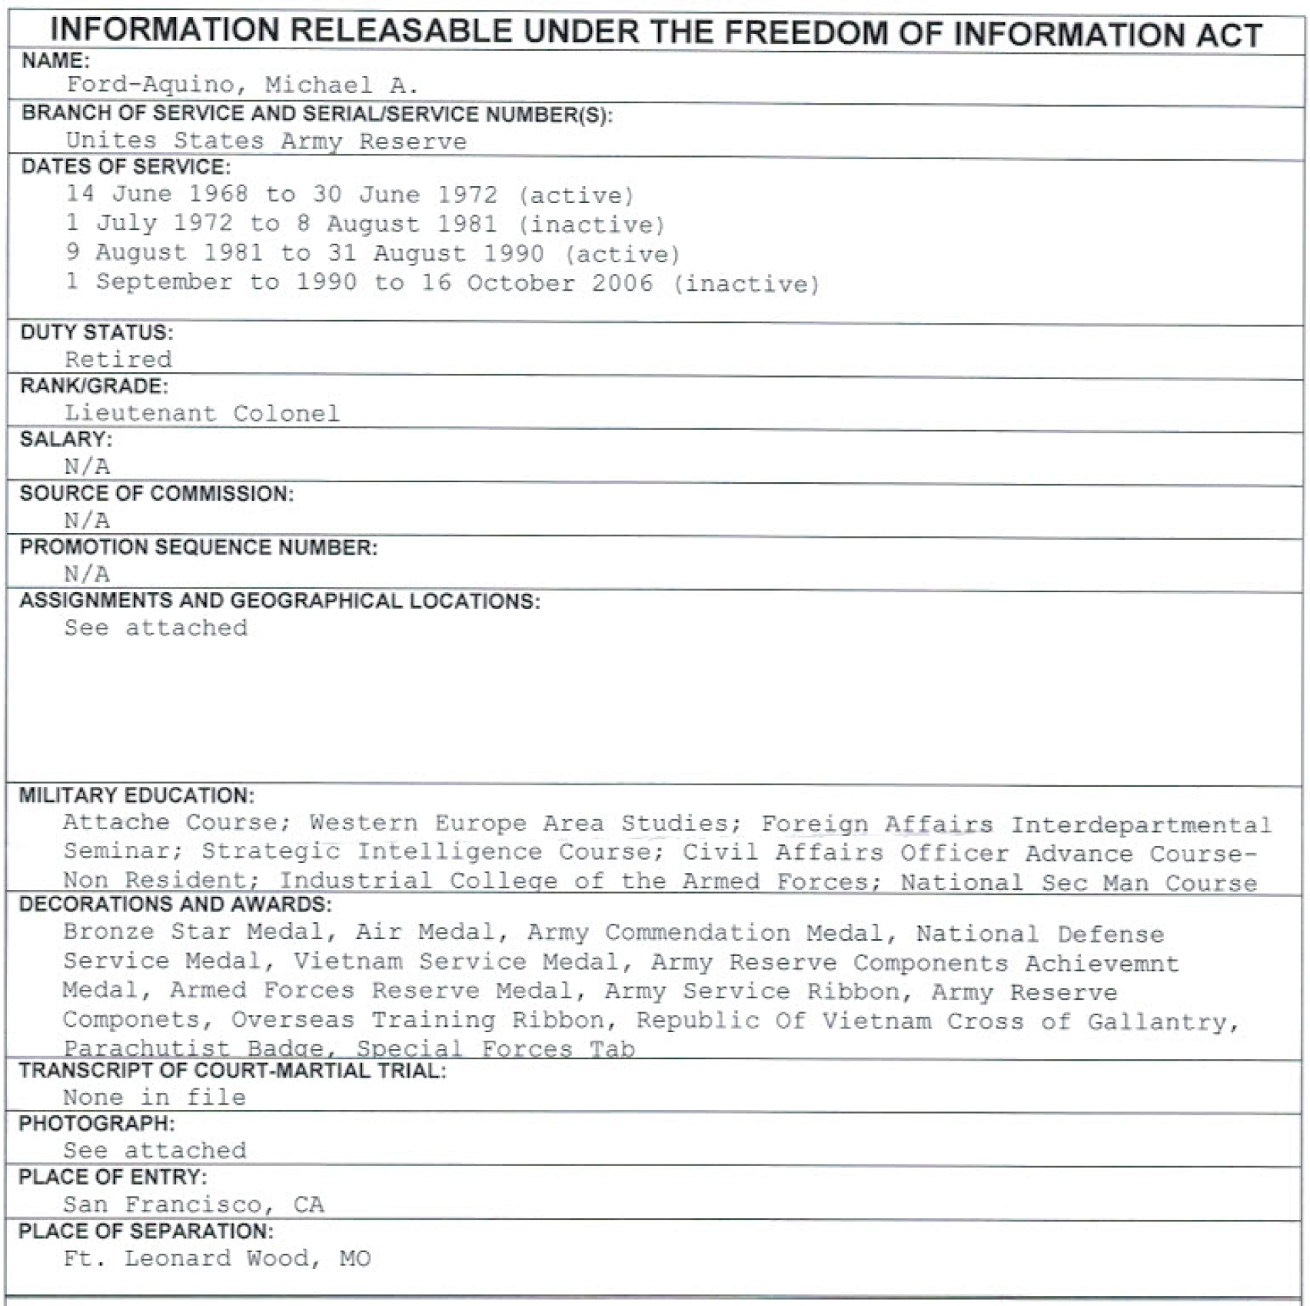
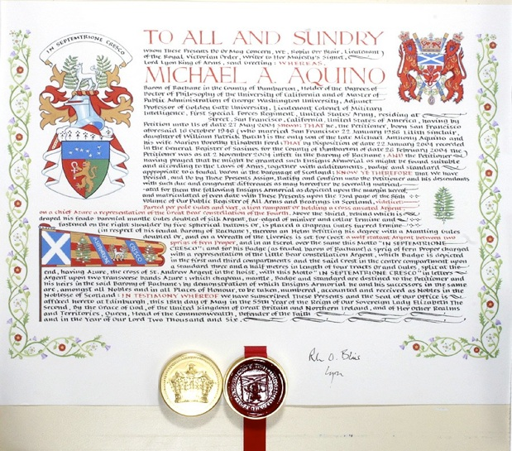
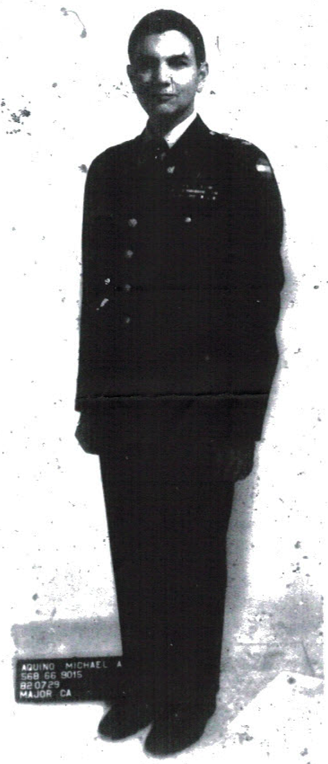
Notes:
Military record from FOIA request, Aquino FOIA.PDF

Slide 12
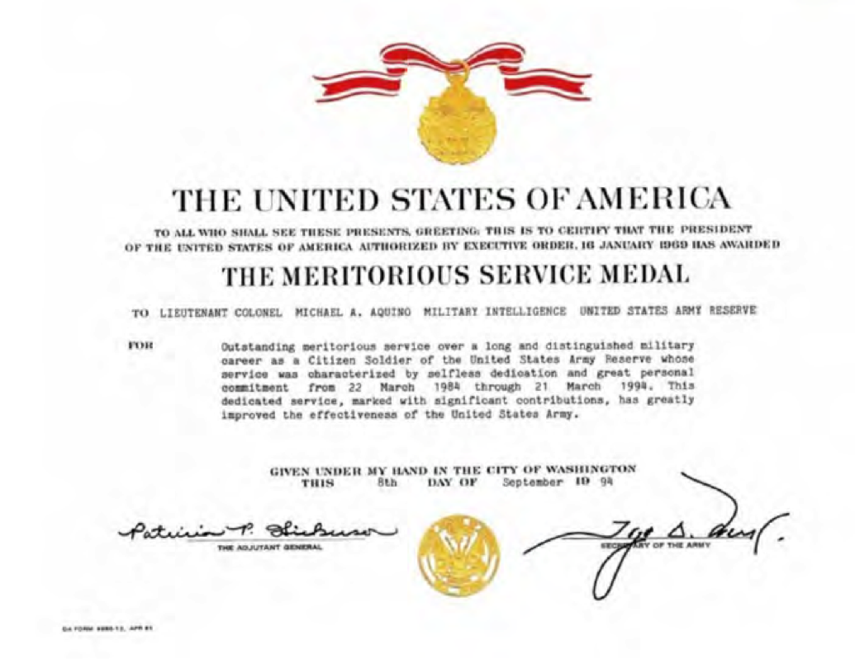
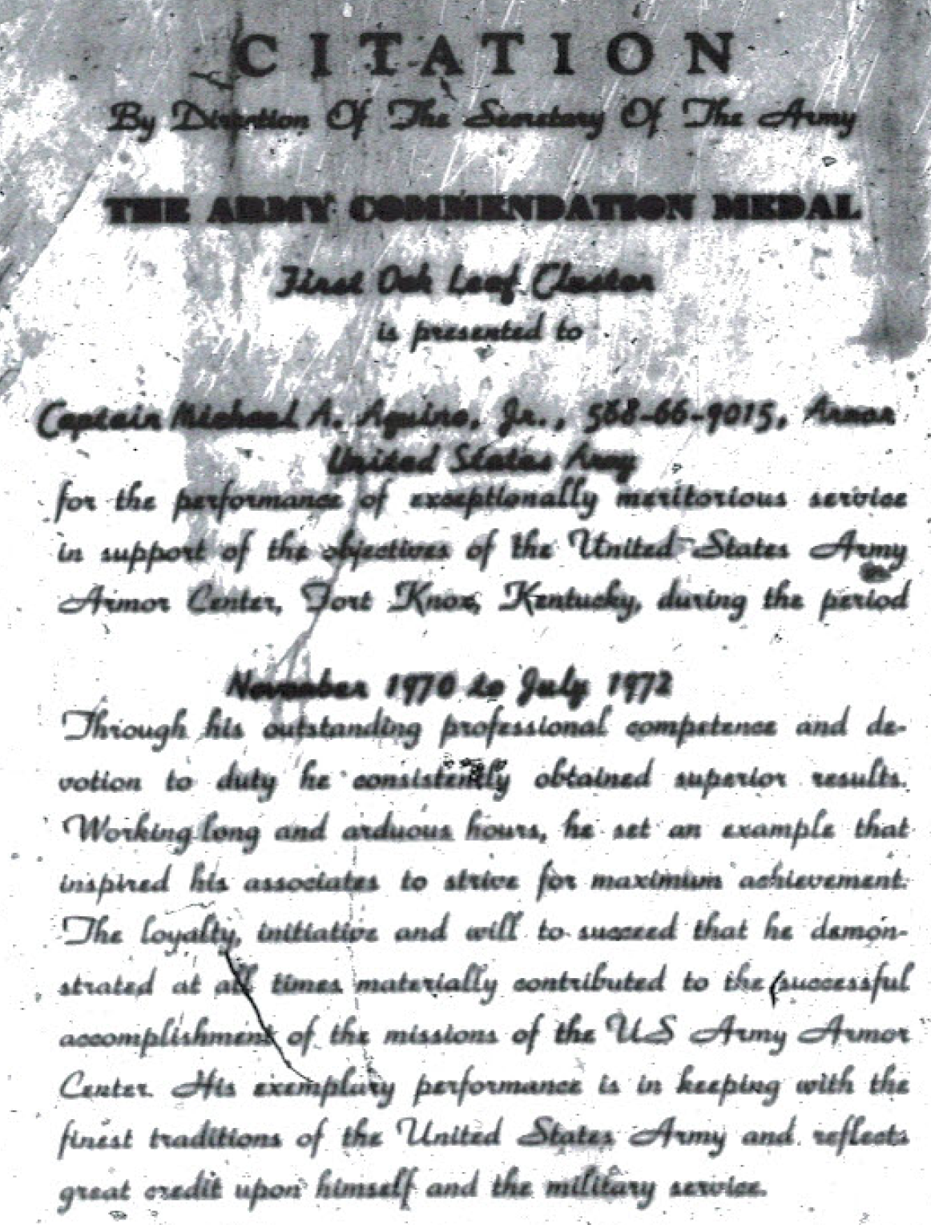
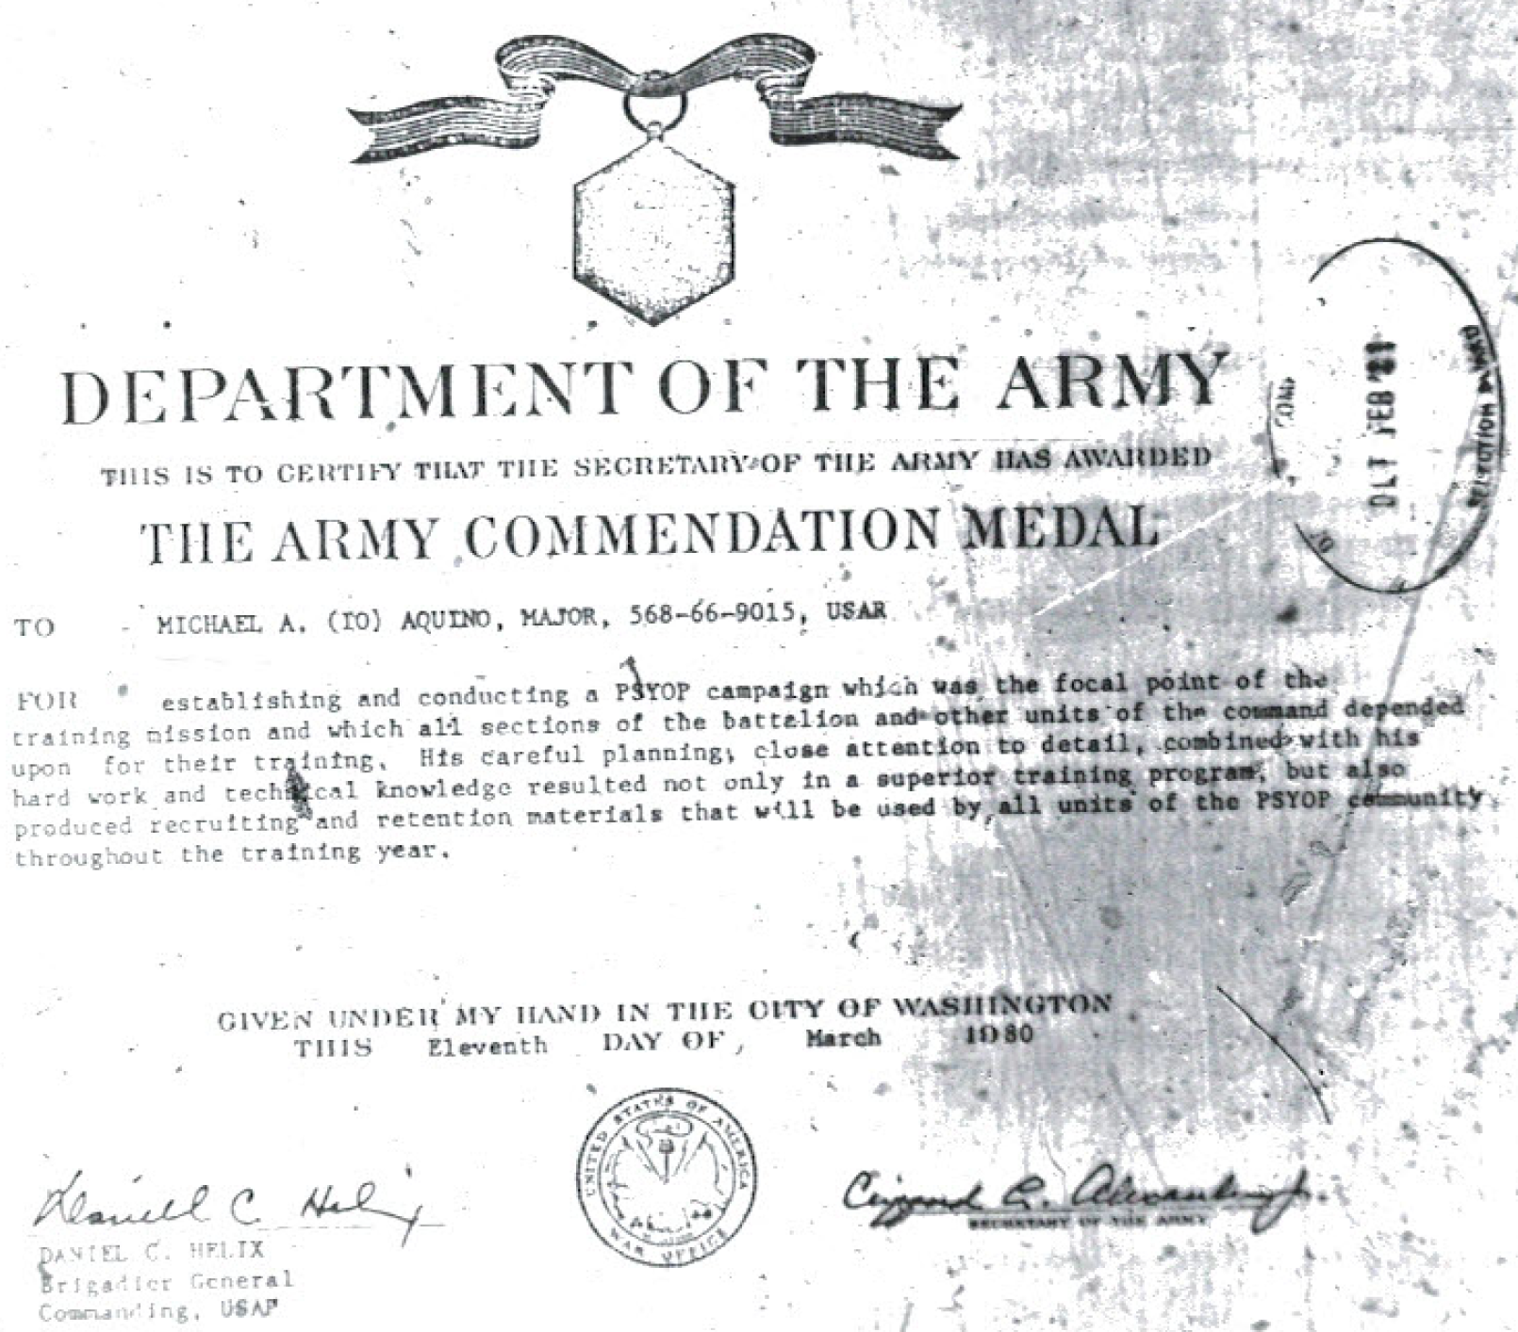
Highly Decorated

Slide 13
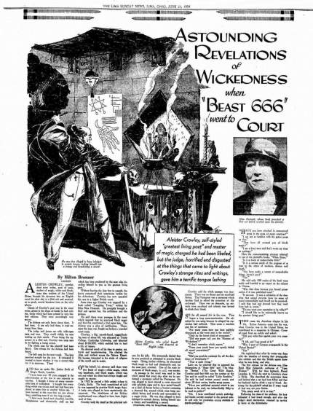
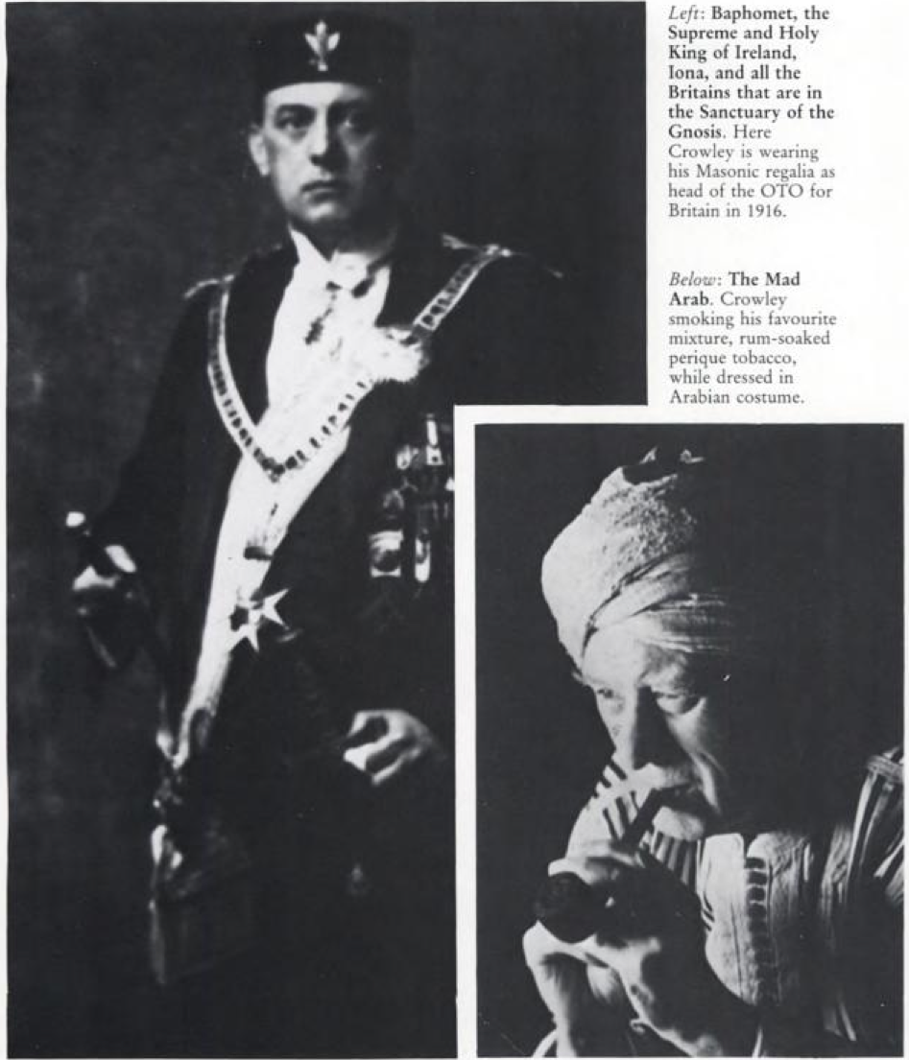
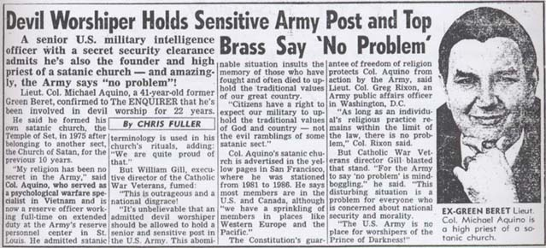
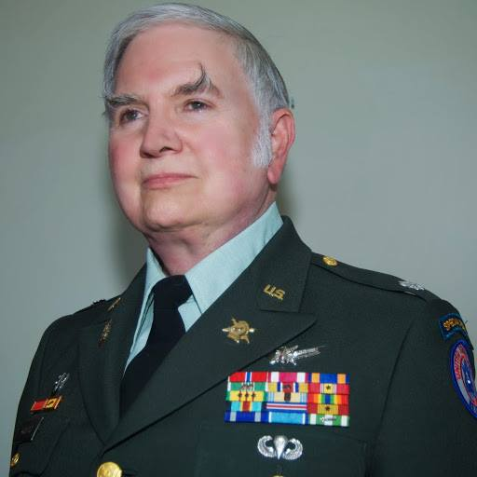
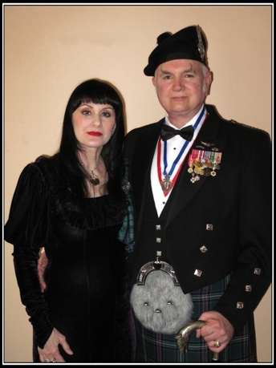
Passing the Satanic Baton
It was to the mantle of Aleister Crowley that Michael Aquino seemed to aspire. While LaVey used some of Crowley’s concepts and materials as they suited him, Aquino took Crowley and his “gospel” quite seriously. In fact, Aquino saw his mission as:
“…to destroy the influence of conventional religion in human affairs...not so much that we want everyone to be converted to Satanism as an institutional religion, but that we want to unravel the web of fear and superstition that has perpetuated all formal beliefs. Satanism should not be just another religion. It should be an unreligion.” (1971)
Image: the National Enquirer
Image: wikia
Image: abovetopsecret
Notes:
COINCIDENCE 1 Leary also saw himself carrying out Crowley’s vision;
named after Crowley’s Babalon Working, Aquino conducted a Babalon Working in Wewelsburg before the Internet project was launched
http://www.amazon.com/Lucifer-Dethroned-William-Sharon-Schnoebelen/dp/0937958417
National Enquirer story via: http://national-paranormal-society.org/michael-aquino/
Lt Col Baron Dr Michael Aquino and his wife Lilith, L; wearing medals, what looks like Masonic garb, and a kilt related to his 13th Barony of Rachane, affiliated with Clan Campbell
Image from AboveTopSecret.com http://www.abovetopsecret.com/forum/thread972356/pg6
In military uniform with medals and ribbons: http://illuminati.wikia.com/wiki/Michael_Aquino
Aleister Crowley in full Masonic regalia ; from Rense.com Is Satanism in your School Yard http://www.rense.com/general61/satanism2.htm
Note 4994/8350 Lords of the Left Hand Path by Stephen Flowers, Aquino saw Crowley as flawed and himself and his own Setian system as superior. The Book of Coming Forth by Night, written on the summer solstice as Aquino was channeling Satan in Santa Barbara, makes direct reference to Crowley’s channeled Book of the Law and claims to be from the same source. https://www.scribd.com/doc/148658463/The-Book-of-Coming-Forth-by-Night
Cf. Leary clip talking about doing Crowley’s work.
Crowley and Gerald Gardner, the father of Wicca stayed in the same bungalow in Ceylon around 1990. https://en.wikipedia.org/wiki/Gerald_Gardner_(Wiccan)
Unreligion = UN Religion?
Quote is from correspondence with Arthur Lyons: http://www.satanservice.org/propaganda/acad.80se.txt
Lt Col Dr Michael Aquino profile: http://www.encyclopedia.com/doc/1G2-3403800290.html
Crowley was a Freemason:
From Aleister Crowley The Greatest Magician of the 20th Century? by Wes Penre, Dec 29, 1998
“Do what thou will shall be the whole of the Law” [The work of the OTO ... is geared towards the achievement of a world-spanning empire ... The Law “Do what thou wilt” is the law of this new state – a One World Government] was his motto for the OTO, which was the secret order he himself was the Grandmaster of. He rejected traditional morality in favor of the life of a drug addict and brutal womanizer (“I rave; and I rape and I rip and I rend” is a line from one of his poems). He even enjoyed being called the “wickedest man in the world”. He was married twice, and both his wives went insane. Five of his mistresses committed suicide.
Although the above is true, Crowley found great amusement in trying to shock his environment, the sleeping population, and when the newspapers named him “The Wickedest Man in the World”, he was very pleased. Due to his nature of wanting to shock people, he also sometimes exaggerated to create an effect.
People who met Crowley verified that he had occult powers, and as an example William Seabrook tells the following story: Seabrook wanted a demonstration of Crowley’s powers, so the latter chose a man at random out on the street and followed him, imitating his walk. Suddenly Crowley fell, but was rapidly on his feet again. At the same time the other man fell on the sidewalk. Crowley and his companion helped the man up, and he looked confused, trying to find the banana peel.
Crowley is often credited as the man who came up with the idea of putting backwards messages into musical recordings. On Beatles, the Rolling Stones and Led Zeppelin albums these messages can be heard (all those three rock bands are/were Crowley disciples). There are, for example, infamous backward satanic messages on the mega hit “Stairway to Heaven” (“Here’s to my sweet Satan” is one of many messages that appear). Jimmy Page and Robert Plant, the two front figures in the band deny this, but the messages clearly appear when the song is played backwards. Page also bought Crowley’s mansion in Scotland and he doesn't make a secret of that he is a long time disciple of Crowley's, as was the late drummer John Bonham from the same group. Beatles also had backwards messages like “Paul is dead” on their albums and Crowley’s head is present on the cover of “Sgt. Pepper’s Lonely Hearts Club Band”. When asked why all those people were portrayed on cover of the album, the Beatles replied and said those were people they admired. Aleister Crowley was born in Warwickshire where he revolted against a strict religious childhood. He left his studies and became initiated into the secret order of the Golden Dawn in 1898. After some time he came into conflict with its leaders and went to Mexico. From there he traveled a lot, to India and Ceylon, where he studied yoga and Buddhism. Buddhism replaced his occult interests for a while, until he got a strange experience in Cairo, Egypt in 1904. By curiosity his wife Rose asked him to do an occult ritual. She then went into a state of trance and brought down a message from some strange being. “He’s waiting for you”, she told Crowley. “Him”, she said, was Horus, the God of wars and the son of Osiris in the old Egyptian mythology.
At first, Crowley didn’t believe her, so he started asking her a few questions to reveal her as a fraud. But Rose, who didn’t know very much about the occult, gave the correct answers.
The message that was sent to Crowley, told him to sit down by his desk a certain time three days in a row. He o
ed and in these three days he wrote “The Book of Law” with automatic writing. This means his hand was moving by another force than his own.
Crowley’s messenger taught that the old Age of Osiris soon would follow by the new Age of Horus. But first Earth must bathe in blood. There should be a World War. The Book of Law told about a race of Superhuman and condemned the old religions, the pacifism, democracy, compassion and humanity. “Let my servants be few and secret, they shall reign over the many and the known”, the Superhuman continued. The rest of the message goes in the same spirit. The lower races should be humiliated and condemned and even killed. It taught “no mercy”. [Long before the Roswell incident, where a flying saucer crashed in the desert and dead aliens were found, Crowley made a drawing of one of his “messengers” called Lam – the drawing is almost identical with the Grey Aliens, who nowadays are so broadly mentioned and used in movies and among abducted].
The messenger also declared that Crowley was the Beast 666 from the “Book of Revelations” (13:18), who had come to destroy Christianity. He tried to forget the whole thing, but from 1909 and forwards, he started taking the messages seriously.
Crowley then left his former occult teacher MacGregor Mathers, who by that time was a broken man. Mathers started a psychic war against Crowley. They called up demons with whom they attacked each other, and Mathers lost. Such demonic warfare is very common today among the Brotherhood.
Long after his death, Crowley became a hero for many young people within the flower-power movement. The irony in all this is that these young people cried for peace and love. Crowley in his turn welcomed the First World War, as necessary to sweep away the old age and start the new one. Since he revealed his revelations, he became the head of the OTO (Ordo Templi Orientis) in Germany, which gave him a great influence over similar people in Germany. It’s also well known that Hitler was influenced by him and that Crowley himself tried to contact Hitler during the 2nd World War.
CROWLEY AND FREEMASONRY
In his book “Confessions ...”, Crowley claimed that he had been initiated as a 33rd Degree Mason in the Ancient and Accepted Rite of Masonry (A&AR). He probably did this in Mexico, where he went after breaking up with the Golden Dawn. At this time (around 1900) there was a lot of Masonic activity in South America. However, there is some confusion regarding this, as you have to be a Master Mason to be initiated on the Higher Grades, and by this time Crowley hadn’t gone through the grades required, so either he made it up or was granted the 33 degree without prerequisites necessary. In his own words he received the initiation after he had helped an individual with another mystical order called LIL. No one seems to know for sure what the real truth of the matter is.
It looks though, as if he at one point or another was initiated, as a copy of his recognition still exists. This is a reproduction:
T. T. G. O. T. S. A. O. T. U. DEUS MEUMQUE JUS SPES MEA IN DEO EST ( Great Seal ) SUPREME GRAND COUNCIL OF THE ILLUSTRIOUS PRINCE OF THE ROYAL SECRET POST PUISSANT SOVEREIGN GRAND INSPECTORS GENERAL of the 33rd AND LAST DEGREE ANCIENT AND ACCEPTED RITE OF MASONRY H.R.D.M. R.M.S.H. SITTING IN THE VALLEY OF MANCHESTER
From the East of the SUPREME GRAND COUNCIL of the SOVEREIGN GRAND INSPECTORS GENERAL of the 33rd and last degree of the Ancient and Accepted Rite of Freemasonry in and for Great Britain and Ireland under G.L. near the D.B. corresponding to 53’, 25” N. Latitude 2’, 3” West Meridian of Greenwich. To all Illustrious, Ineffable and Sublime Freemasons of every degree Around and [unclear] over the surface of the Globe, Greetings: KNOW YE – That the undersigned Sovereign Grand Inspectors General do hereby certify and proclaim, our Illustrious Brother ALEISTER CROWLEY of *London*, to be an Excellent Master Mason, Secret Master, Royal Master, intimate Secretary, Provost and Judge, Intendant of the Building, Elect of Nine, Elect of Fifteen, Sublime Knight Elected, Grand Master Architect, Ancient Master of the Royal Arch, Grand Elect Perfect and Sublime Mason, Knight of the Temple, Prince of Jerusalem, Knight of the East and West, Knight Rose Croix of Heredom, Grand Pontiff, Master ad Vitam, Patriarch Noachite, Prince of Libanus, Chief of the Tabernacle, Prince of the Tabernacle, Knight of the Brazen Serpent, Prince of Mercy, Commander of the Temple, Knight of the Sun, Knight of Saint Andrew, Grand Elect Knight Kadosh, Grand Inspector Inquisitor Commander, Prince of the Royal Secret, Most Puissant Sovereign Grand Inspector General of the 33rd and Last Degree. WE ALSO COMMAND: All the Knights, Princes and Sublime Masons under our Jurisdiction and we pray all other MASONS over the Surface Of The Globe, to Welcome and Honor Him as a SOVEREIGN GRAND INSPECTOR GENERAL, and to give credit to these LETTERS PATENT, we have caused to be signed in the margin by our said Illustrious Bro. ALEISTER CROWLEY, that they admit no other than himself. Signed and Delivered by us SOVEREIGN GRAND INSPECTORS GENERAL of The 33rd and Last Degree with the Seal of our said SUPREME COUNCIL affixed in the Valley of Manchester this 29th day of the 11th month A.M. 5071 corresponding to the 29th November, A.D. 1910.
RATIFIED AND CONFIRMED {*} John Yarker 33~ M.^.P.^.S.^.Gr.^.of Gt. Britain & Ireland
Crowley’s cult is one of Sun worship. From Ten Myths About Aleister Crowley That Are Actually True http://ac2012.com/2012/08/05/aleister-crowley-myths-actually-true/ :
1. Aleister Crowley was a solar myth.
When Aleister Crowley was asked during a trial to explain his office, Crowley replied, “‘The Beast 666’ only means ‘sunlight’. You can call me ‘Little Sunshine.'”
In some ways, it is easier to believe that Aleister Crowley is a myth than to believe that he could have been a single, mortal human being. In this myth of Aleister Crowley we find a person who has excelled in three completely distinct careers, which he classifies as “the Secret Way of the Initiate, the Path of Poetry and Philosophy, and the Open Sea of Romance and Adventure.” Aleister Crowley points out that in truly great men, we might find one or two of these facets, but never all three. He concludes:
… in this particular instance all three careers are so full that posterity might well be excused for surmising that not one but several individuals were combined in a legend, or even for taking the next step and saying: This Aleister Crowley was not a man, or even a number of men; he is obviously a solar myth. — The Confessions of Aleister Crowley, Part 1, Prelude
“Our religion therefore, for the People, is the Cult of the Sun, who is our particular star of the Body of Nuit, from whom, in the strictest scientific sense, come this earth, a chilled spark of Him, and all our Light and Life.” — Commentary on Liber AL vel Legis III:22
Quote source: "Satan Wants You” by Arthur Lyons http://www.satanservice.org/propaganda/acad.80se.txt

Slide 14
The Temple of Set
“The U.S. military was heavily represented at the Temple. William Butch, Aquino’s brother-in-law, a former Pittsburgh police officer, was a naval reservist. Bruce Bibee, a former captain in Aquino’s psyop unit in San Pedro, enlisted in the Temple. Captain Willie Browning was a military intelligence officer. Setian Dennis K. Mann was a reserve Army major in the intelligence field. An Army CID investigative report filed with the San Francisco Police Department notes that an informal check of official records revealed that Mann and Browning were "Captains, Military Intelligence.” Black Ops. Aquino himself has served stints as a Green Beret, a liaison officer in NATO countries, and a consulting faculty member at the U.S. Army Command and General Staff.
The promising young Satanist’s military function in Vietnam was "human ecology" – a CIA code-word for behavior modification and mind control. Major Jack Downing, a self-professed "Man in Black," recalls, "I was working alongside the CIA as a consultant in psyops and as a specialist in ‘human ecology.’ That's a phrase that connotes different things, depending on the context, from the wholesome to the not-so-wholesome. In the capacity for which I was employed, it was a way of pinning down the psyche and behaviors of human beings in differing environments or under various circumstances. It employed the observational principles of anthropologists and psychologists alongside the more manipulative techniques of advertisers, social engineers and ‘golden age’ brainwashers. It was, in retrospect, a very unorthodox and ethically questionable thing." Downing says "we brought the MK [mind control] projects into the war. The extreme circumstances of warfare gave us excellent opportunities to observe the ways certain mind control technologies might work." Downing was in Germany applying "some of the findings we got." He set up "some things" at Army bases stateside. "At the time of my leaving, my role … as human ecology expert was taken up by another officer, a Michael Aquino, who was trying out these [mind control] principles in the context of Anton LaVey's church”
– Alex Constantine, Michael Aquino Revisited – Was He Guilty?
Aquino founded the Temple of Set on a beach in Santa Barbara on the North Solstice, June 1975,
He channeled the “Book of the Law” the same way Crowley obtained his book.
Notes:
http://aconstantineblacklist.blogspot.com/2007/08/michael-aquino-revisited-was-he-guilty.html
The quote from Downing – later a member of the Temple of Set
KHPR: http://khprvod.org/2009/12/khpr-001-so-youre-thinking-of-joining-the-temple-of-set/

Slide 15
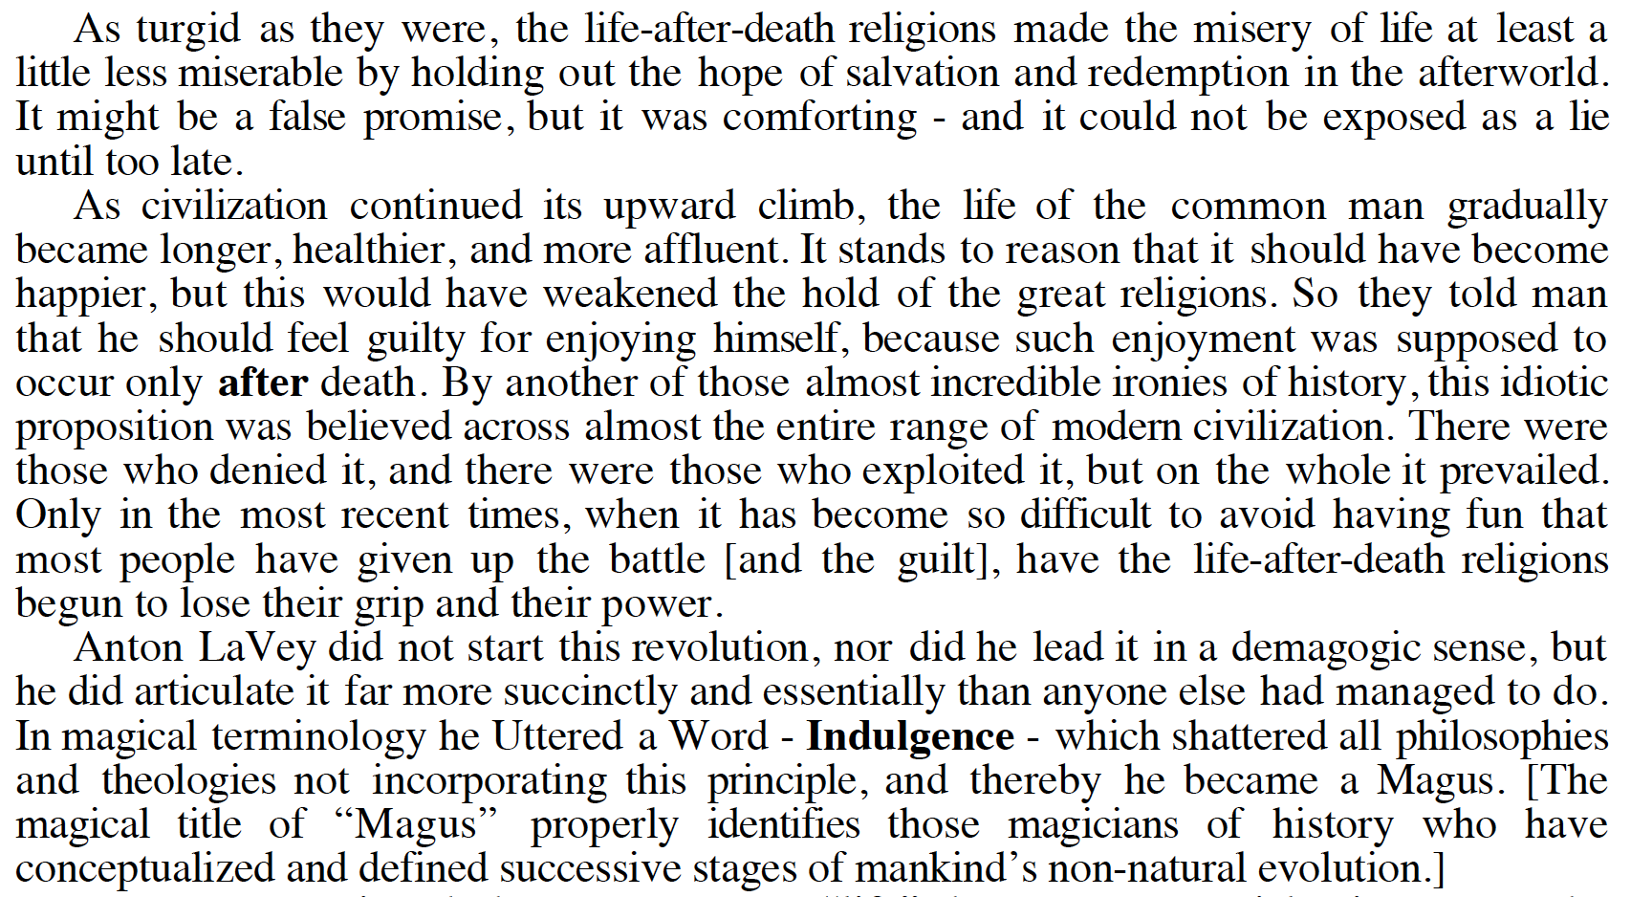
Selfless Sacrifice for Self-Is-God
“At its most elemental level, “sacrifice” implies the giving up of something precious to oneself in return for some other benefit or favor. Human beings being the selfish creatures they are, it has always seemed preferable to give up something precious to others in order to obtain the expected benefit”.
Notes:
Church of Satan by Michael Aquino, pg 63
http://www.amazon.com/Church-Satan-I-Michael-Aquino-ebook/dp/B00Y4GRAD6/ref=sr_1_4?s=digital-text&ie=UTF8&qid=1461173853&sr=1-4
Quote is from p61

Slide 16
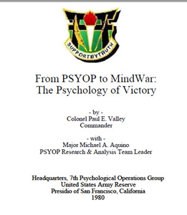
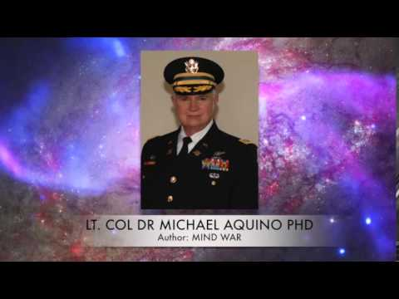
MindWar THE PSYCHOLOGY OF VICTORY
a permanent state of strategic psychological warfare against the populations of friend and foe nations alike
"On the premise that war is endemic to the human disposition, MindWar proposes to eliminate its killing and destruction by replacing it with a far more powerful kind of war - one which focuses on the human mind both individually and collectively. The persons and property of people are removed as targets, replaced by the divisive situations and problems originating in their consciousness. These are then controlled, adjusted, and reformed to produce a harmonious and cooperative total environment.
In its strategic context, mindwar must reach out to friends, enemies and neutrals alike across the globe ... through the media possessed by the United States which have the capabilities to reach virtually all people on the face of the Earth. These media are, of course, the electronic media—television and radio. State of the art developments in satellite communication, video recording techniques, and laser and optical transmission of broadcasts make possible a penetration of the minds of the world…
The price for this solution is that, for the first time in practical history, the actual machinery of human thought is accessed, by the methodical application of science, psychology, and esoteric arts of antiquity. MindWar assumes, as did the ancients, that the ultimate aspiration of mankind is to the Good. But, like the Manhattan Project which rashly opened an earlier genie's bottle, MindWar could be misused with even more ominous consequences. Devised to save humanity, it could also supersede it. Hence this genie must be examined and evaluated while its bottle is still sealed. This book extrapolation and evolution of the original 1980 concept is not merely theoretical. It proposes "laboratory" implementation through the structural redesign of the U.S. Army’s three “Special Operations” branches: Psychological Operations, Special Forces, and Civil Affairs.”
Image: YouTube
“There are some purely natural conditions under which minds may become more or less receptive to ideas, and MindWar should take full advantage of such phenomena as atmospheric electromagnetic activity, air ionization, and extremely low frequency waves”
FULL * SPECTRUM * DOMINANCE
Image: YouTube
Notes:
Michael Aquino and Paul Vallely, From PSYOP to MindWar – The Psychology of Victory (1980, with 2003 introduction by Aquino) https://archive.org/details/pdfy-Mv-q4qGq8_TBPcwL
"mindwar" is a permanent state of strategic psychological warfare against the populations of friend and foe nations alike. "In its strategic context, mindwar must reach out to friends, enemies and neutrals alike across the globe ... through the media possessed by the United States which have the capabilities to reach virtually all people on the face of the Earth. These media are, of course, the electronic media—television and radio. State of the art developments in satellite communication, video recording techniques, and laser and optical transmission of broadcasts make possible a penetration of the minds of the world such as would have been inconceivable just a few years ago."
“The supreme art of war is to subdue the enemy without fighting” – Sun Tsu, The Art of War 513 BC https://en.wikipedia.org/wiki/The_Art_of_War

Slide 17
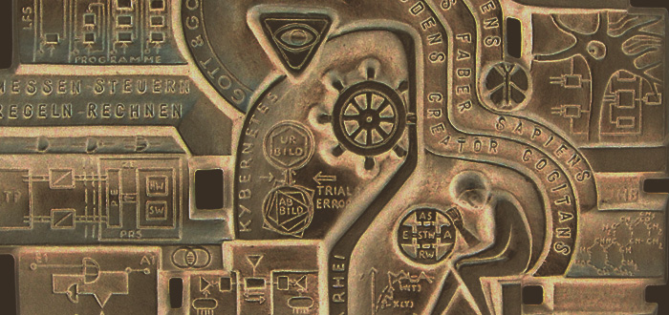
Temple of Set and A.I.
Everyone knows that computers and computer science are continuing to mushroom, but few really know just how much and with what impact. The reality is astonishing in some ways and overblown in others. Industrialized civilizations of the planet are now so dependent upon computerized systems of commerce and communication that they are close to being "at the mercy" of the computer scientist, whose responsibility it is to "make the things work" - and, incidentally, to set parameters for human enterprise by taking computer design in one direction or another. Obviously a computer-dominated society is hyperefficient in some ways, hypervulnerable in others.
At the very least the magician must know enough about the field so that he is sensitive to the ways in which it influences him - and the ways in which he may use it to influence others - Michael Aquino, The Crystal Tablet of Set, 1989
Image: conspiracyarchive
Notes:
http://www.conspiracyarchive.com/2013/11/27/a-strange-metallic-plaque-with-cybernetic-occult-symbolism/

Slide 18
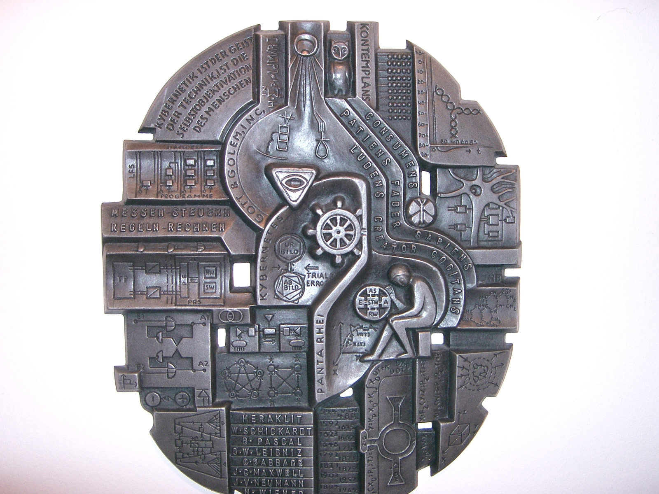
Image: conspiracyarchive
Notes:
http://www.conspiracyarchive.com/2013/11/27/a-strange-metallic-plaque-with-cybernetic-occult-symbolism/

Slide 19
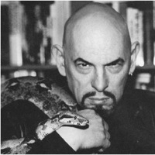
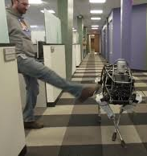
Church of Satan & Transhumanism
Image: Wikipedia
Anton LaVey
“Why do I prefer androids to many “real” humans?”
“Androids can be created, programmed, utilized exactly according the Master’s whims. They require no energy-consuming interaction in order to salve a non-existent ego. Yet even the semblance of an ego can be built into an android via actions and words – but always according to the Maker’s requirements. They can be shelved when they grow tiresome, brought back out when needed, modified in appearance, and destroyed without moral conscience.”
“They are ideal companions. They never talk back, unless you want them to, yet you can insult them to your heart’s content. Insofar as work is concerned, that can be performed by either non-humanoid machines or humans of limited intelligence operating machines of greater intelligence.” – Anton LaVey
Image: YouTube
Image: YouTube
Image: evilyoshida
Image: YouTube
Image: YouTube
Notes:
Coincidence: 1 Google called their OS Android, and is the world’s largest maker of military robots. The CoS goal seems to be similar to transhumanist goals.
Pg 244 , The Church of Satan by Michael Aquino. Quote is from Anton La Vey, writing in Cloven Hoof
http://exposinginfragard.blogspot.com/2014/02/the-case-against-michael-aquino-satanic.html
From “The Devil’s Notebook”
http://antonszandorlavey.tripod.com/asl_misanthropia.html
Anton LaVey image: https://en.wikipedia.org/wiki/Anton_LaVey
SkyNet image: http://www.evilyoshida.com/thread-6282.html

Slide 20
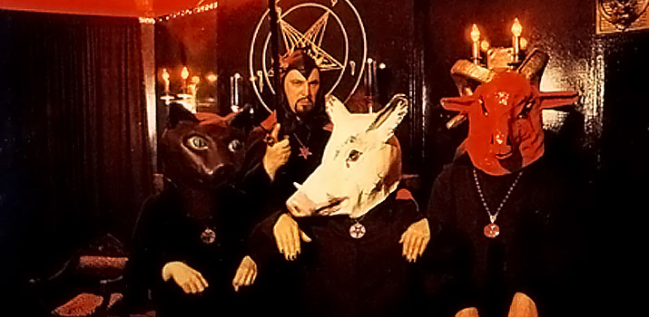
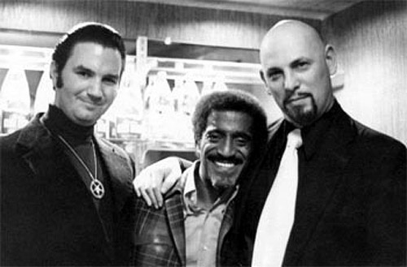
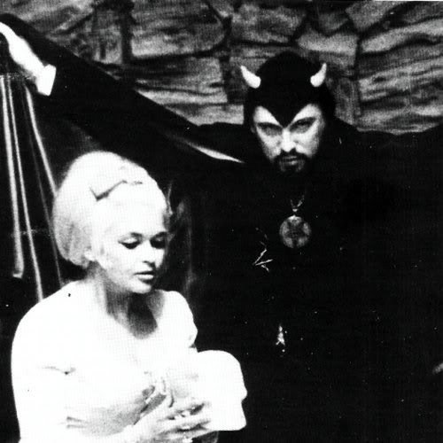
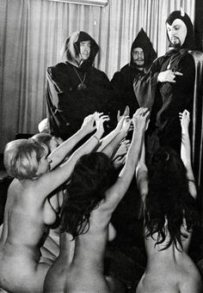
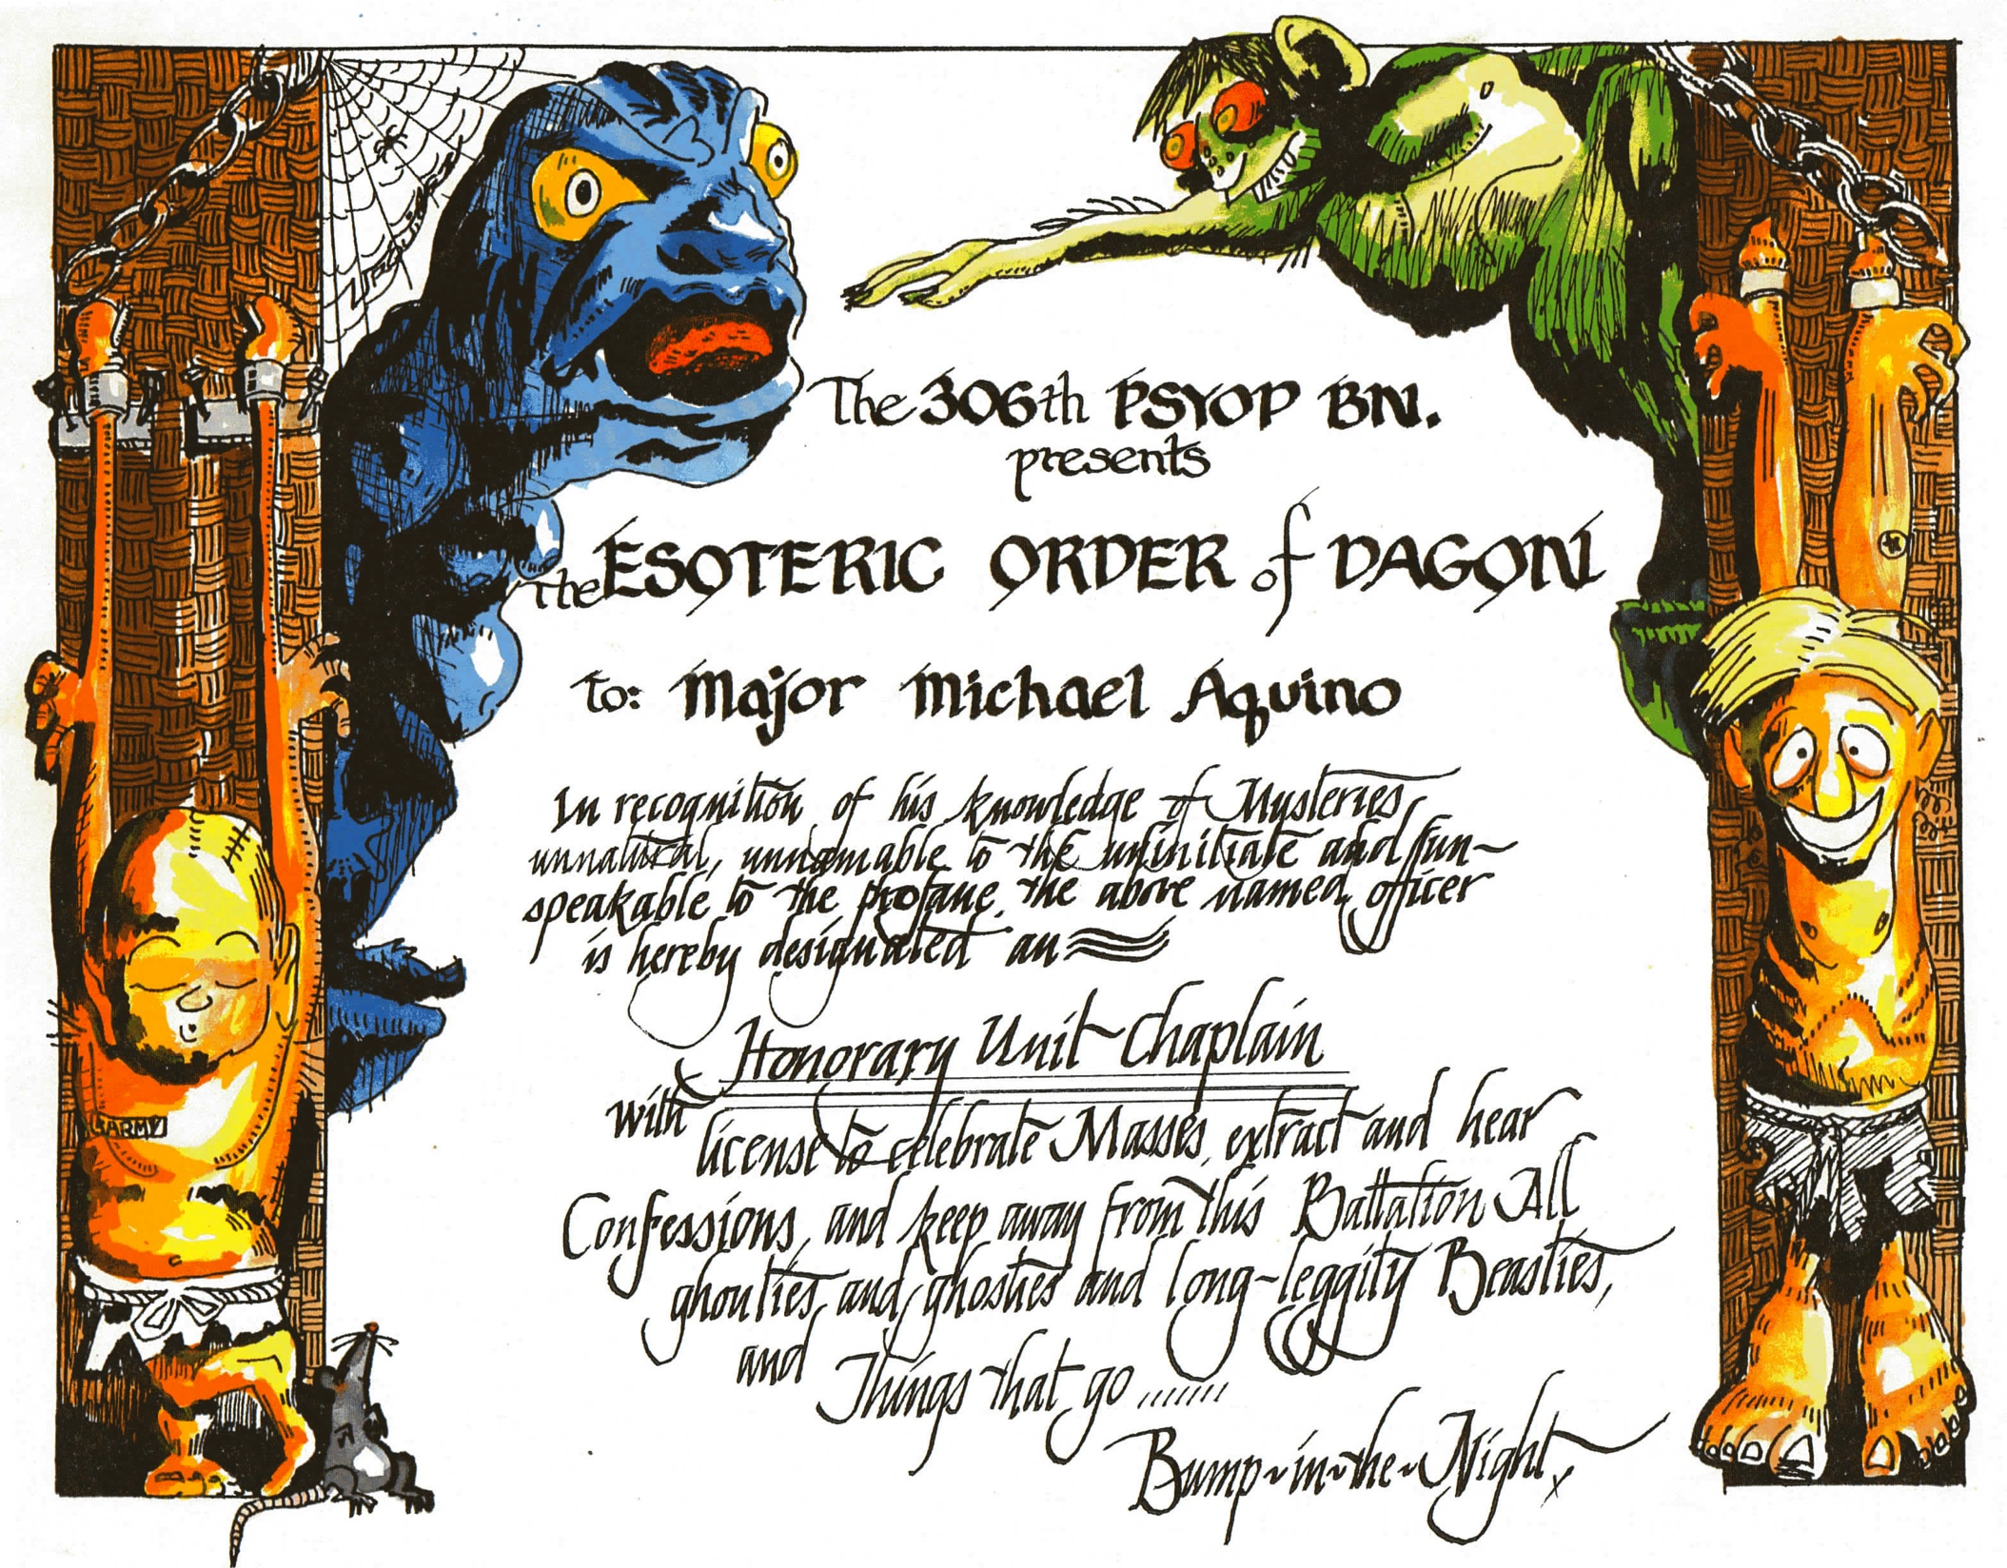
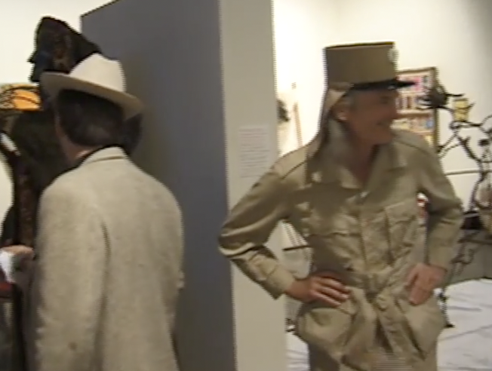
Church of Satan Master Plan
“The church cannot sustain itself on the altruism and loyal dedication of its present “supermen” followers. In due time, after conditioning has been achieved and the movement has grown vast, human potential can be categorized into shouters, money-donors, leaders, legitimacy-providers, menial volunteers, etc. – just as past religions which have dealt with human animals have done. Each person’s respective value can then be extracted, and the Temples and Pleasure Domes can be built … according to our plans.” “The four principal devils are: Leviathan, representing the sea; Lucifer, the lord of the air or bearer of light; Belial, the lord of the earth; and Satan, lord of the fire. One of the main goals of the Church of Satan is to build pleasure domes in which the members of the Church can indulge themselves in their personal desires. By having a place to go where they can release their desires, the members can lead an unfrustrated life in the everyday world…A pleasure dome would consist of many different rooms and recreational facilities for the purpose of fulfilling each member’s personal desires.” – Anton Szandor LaVey in The Church of Satan by Michael Aquino (1983)
Images: churchofsatan.com
Michael Aquino on his time in the 306th Psychological Operations Battalion in LA in the 70’s: “[T]he 306th seemed to attract every mad scientist, character actor, and miscellaneous weirdo in the Los Angeles area. One group of officers, dearly beloved by the battalion, decked out their office on the post as a medieval chamber, complete with candelabra, wine-bottles, sumptuous rugs, and antique oak furniture. They were served wine by nude wenches, whose photographs appeared charmingly on the walls. Often these gallants, who had forsaken ordinary U.S. Army uniforms for custom-designed ones of Ruritarian splendor, would conduct impromptu duels with fencing sabres. It was not uncommon for the battalion staff to be holding a briefing for the commander (a World War II command bomber pilot) while the clash of steel was heard through the window.”
Image: YouTube
Notes:
Images:
http://vigilantcitizen.com/vigilantreport/hidden-life-kennedys-elite-dynasty-got-decimated-pt-ii/
http://www.revolvermag.com/news/6-famous-members-of-the-church-of-satan.html
https://www.pinterest.com/pin/130322982941188177/
Quote is from The Church of Satan by Michael Aquino, pg 438. The preceding line reads:
The Satanic Seasons:
Satan = Summer
Lucifer = Spring
Belial = Fall
Leviathan = Winter
When South Park went to Burning Man, it was in the episode “Coon and Friends”, featuring HP Lovecraft’s demon Cthulhu. The Esoteric Order of Dagon, seen here awarded to Lt Col Michael Aquino, is related to Cthulhu worship.
http://southpark.cc.com/clips/360470/burning-man
Order of Dagon are Crowleyan: http://www.esotericorderofdagon.org
Do what thou wilt shall be the whole of the Law. Ph’nglui mglw’nafh Cthulhu R’lyeh wgah'nagl fhtagn.
The Esoteric Order of Dagon (E.'.O.'.D.'.) is a serious occult Order which has been working Lovecraftian magick for nearly 30 years. The E.'.O.'.D.'. utilizes the so-called Cthulhu Mythos of the horror and fantasy writer H. P. Lovecraft as a magickal method of exploring the Collective Unconscious. The Order claims descent from the traditions of the Sirius mystery cults of ancient Egypt and Sumeria. Other influences include Kenneth Grant, the British occultist, disciple of Aleister Crowley, and head of the Typhonian Order, who also attaches great occult significance to the writings of Lovecraft.
Aquino membership: http://www.esotericorderofdagon.org/eod%20additional%20information.html
Jack Parsons wife Marjorie (Cameron, the Scarlet Harlot) made a movie in 1954 with Satanist Kenneth Anger called The Inauguration of the Pleasure Dome, based on a Crowleyan initiation rite
http://www.rottentomatoes.com/m/the_inauguration_of_the_pleasure_dome/
The film features footage of Hell. The Pleasure Domes come from Samuel Taylor Coleridge’s Xanadu
In Xandau did Kubla Khan
A stately pleasure dome decree
Image of Magus Anton Szandor LaVey conducting the Das Tierdrama Ritual. Photo Credit: Church of Satan Archives http://www.churchofsatan.com/
Ruritarian; adjective: of, relating to, or having the characteristics of an imaginary place of high romance (Merriam-Webster dictionary)
From Michael Aquino’s book , The Church of Satan , pages 117, 191, 355-6
““…Then there was a reserved but cheerful lieutenant who all but disappeared behind an oversized field jacket and aviator’s mustache – Bruce Bibee. His hobby was bombs, explosives, and implements of destruction in general, and he proudly wore the Army’s badge for unexploded bomb disposal on his chest. He would later become an Adept II of the Temple of Set.” “The unit’s intelligence officer was indeed a towering presence; his name was Dennis Mann and he stood almost seven feet tall. To confuse people he drove the smallest Fiat made, whose license plate read, “GONZO-1” in honor of his hero, Dr. Hunter S. Thompson (caricatured as “Uncle Duke” in Garry Trudeau’s Doonesbury comic strip). Dennis went on to become a Master of the Temple IV and a member of the Temple of Set’s Council of Nine.” “All of which is to say that I felt right at home in the 306th PSYOP Battalion, and it felt equally happy to have someone on the staff to personify its spiritual climate…” (M. Aquino, The Church of Satan, pgs. 355-6)”
Cf. Timothy Leary’s reference to the important help from “agents in LA” at the MKULTRA reunion party “A Conversation on LSD” https://www.youtube.com/watch?v=_qaumQvMWBA
Lords of the Left-Hand Path: Forbidden Practices and Spiritual Heresies, Dr Stephen E Flowers (6543/9830 Kindle)
Church of Satan has 9 Principles and ruling body “Council of Nine” Larry Harvey originally came up with 9 Principles for Burning Man
In these total environments, the Satanist would be free from a kind of “aesthetic pollution” with which he is usually constantly bombarded, much to the detriment of his ability to indulge his desires
Liberalism is the first line of the Satanic agenda to reverse the natural spiritual order of the Universe, which is the Western ideology: Professor Alexander Rugin, advisor to Russia President Putin, being interviewed by Jay Dyer 12 Mar 2016 (approx 10:00) https://www.youtube.com/watch?v=4AJ-3h6LhUk
Karl Marx was a Satanist. Marx and Satan, Richard Wurmbrand (1986) the Internet Archive: https://archive.org/stream/MarxAndSatan/MarxAndSatan_djvu.txt
http://www.cuttingedge.org/pages/seminar2/MARXPASS.htm

Slide 21
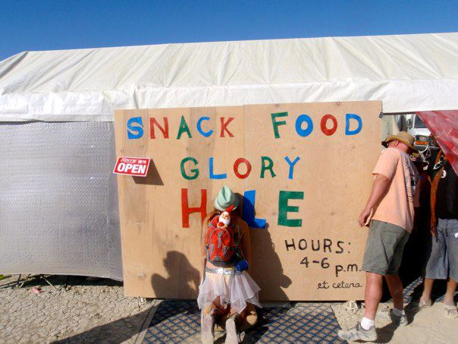
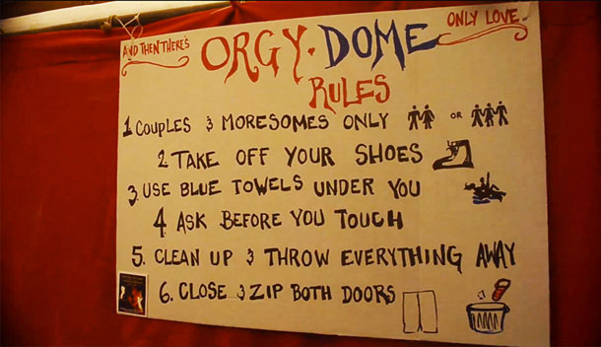
Pleasure Domes and Androids
“Of LaVey’s many radical ideas, none seems as radical as his proposal that Satanists create and dwell in an artificial world and society of their own designs. Here he suggests a new view of cosmology, one that is at once material and a product of the human imagination. The fourth point of LaVey’s five-point program of Pentagonal Revisionism is the design and manufacture of androids to act as artificial human companions or slaves. The fifth point of the program extends this idea to total environments. These are to be privately owned and operated communities or environments that totally conform to the aesthetic wishes of those living or visiting there…In these total environments, the Satanist would be free from a kind of “aesthetic pollution” with which he is usually constantly bombarded, much to the detriment of his ability to indulge his desires”
“Humanity itself is divided into two groups: the Satanic nonconformists (who indulge their genuinely individualized desires) and the “rubes” (who conform overtly or covertly to the herd mentalities of religion, science, politics, fashion, the media, and so forth). The self-aware Satanist is virtually always in a position to prey upon the rubes, the dupes of the mass mentality”
Image: YouTube
Image: eagerexistence.com
Image: cartman.tv
Image: Litttlewoo, via elephant journal
Notes:
[CLIP: SH033 Google CEO calling for Temporary Autonomous Zones] https://vimeo.com/167386612
https://archive.org/stream/LeftHandPath666-2015/259620268-Lords-of-the-Left-Hand-Path-1997_djvu.txt
Snack Food Glory Hole from http://eagerexistence.com/guests/burning-man-rite-of-passage/
Other images http://www.elephantjournal.com/2013/08/dont-have-sex-in-your-tent-troy-dayton/
Image from Burning Man 2015 theme video “Carnival of Mirrors” https://www.youtube.com/watch?v=MId5gOghEhM
http://cartman.tv/storage/reports/id_4439_lang_en.html
From http://burningman.org/event/brc/2015-art-theme/
Classic carnivals, as theaters of illusion, upheld a very strict dividing line that separated carnies, cast as showmen, from members of a naïve public who were labeled chumps and suckers, marks and rubes. Our carnival, however, will perform an even more subversive trick — its motto is Include the Rube. The wall dividing the observer from observed will disappear, as by an act of magic; through the alchemy of interaction, everyone at once can be the carny and the fool.

Slide 22
Who Is Really Running The Propaganda Show?

